Slide 1
A
JOURNEY
OF GRACE

Slide 2
THE WAY
THE TRUTH
THE LIFE
PREVENIENT
GRACE
SAVING
GRACE
SANCTIFYING
GRACE
God goes before us to make a way and to draw us into relationship through prevenient grace.
Jesus rescues us from sin and leads us into the truth that sets us free through saving grace.
The Holy Spirit empowers us to live a life fully consecrated to God through sanctifying grace.

Slide 3
WHAT IS OUR PART ON THE JOURNEY OF GRACE WITH OTHERS?

Slide 4
WHAT IS OUR PART ON THE JOURNEY OF GRACE WITH OTHERS?

Slide 5
Evangelism
When you hear the word “evangelism” what pictures come into your mind?
What is someone who is “evangelizing” doing?

Slide 6
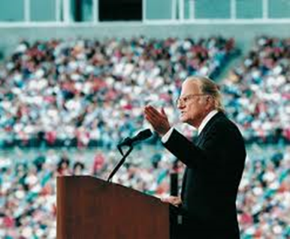
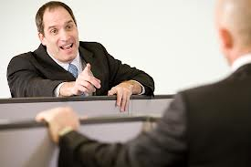
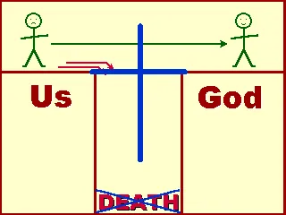
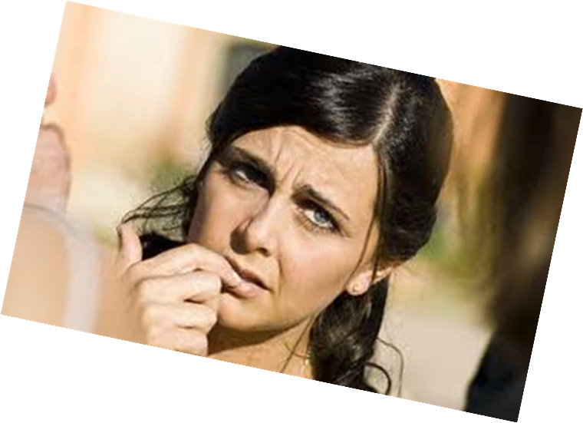

Slide 7
WHAT IF WE THOUGHT OF EVANGELISM AS JOINING THE JOURNEY OF GRACE WITH OTHERS?

Slide 8
Evangelism that is Personal
1. Personal Prayer
2. Sharing Personal Stories
3. Going on Personal Journey’s

Slide 9
Personal Prayer
Prayer is “the hidden mission” of evangelism.

Slide 10
Personal Prayer
Pray for the Holy Spirit to Illuminate people
Ephesians 1:17-19a: I keep asking that the God of our Lord Jesus Christ, the glorious Father, may give you the Spirit of wisdom and revelation, so that you may know him better. I pray that the eyes of your heart may be enlightened in order that you may know the hope to which he has called you, the riches of his glorious inheritance in his holy people, and his incomparably great power for us who believe.

Slide 11
Personal Prayer
Pray for Doors to Be Opened in your relationships with people.
Colossians 4:3: “And pray for us, too, that God may open a door for our message, so that we may proclaim the mystery of Christ, for which I am in chains.”

Slide 12
Personal Prayer
Pray for Courage to Speak when appropriate.
Colossians 4:3: “And pray for us, too, that God may open a door for our message, so that we may proclaim the mystery of Christ, for which I am in chains.”

Slide 13
Personal Prayer
Pray for Clarity of Words to speak when asked.
1 Peter 3:15: “Always be prepared to give an answer to everyone who asks you to give the reason for the hope that you have.”

Slide 14
Personal Prayer
Pray for an Increase in Love:
Ephesians 3:16-19: I pray that out of his glorious riches the Father may strengthen you with power through his Spirit in your inner being, so that Christ may dwell in your hearts through faith. And I pray that you, being rooted and established in love, may have power, together with all the Lord’s holy people, to grasp how wide and long and high and deep is the love of Christ, and to know this love that surpasses knowledge—that you may be filled to the measure of all the fullness of God.
“I pray that _______ may grasp how wide and long and high and deep is the love of Christ. I pray that I might love them as Jesus loves them.”

Slide 15
Breakout Room - Discussion
Who prayed for you to become a follower of Jesus? How do you feel about that person today?
Who are three people you know who are not following Jesus yet? How can you pray for them? What would you ask God to do in their lives?
Take time in the breakout room to pray for one another. Ask God to increase your love for the people you know who are not followers of Jesus.

Slide 16
A
JOURNEY
OF GRACE

Slide 17
WHAT IS OUR PART ON THE JOURNEY OF GRACE WITH OTHERS?

Slide 18
Romans 10:14-15 NLT
14 But how can they call on him to save them unless they believe in him? And how can they believe in him if they have never heard about him? And how can they hear about him unless someone tells them? 15 And how will anyone go and tell them without being sent? That is why the Scriptures say, “How beautiful are the feet of messengers who bring good news!”

Slide 19
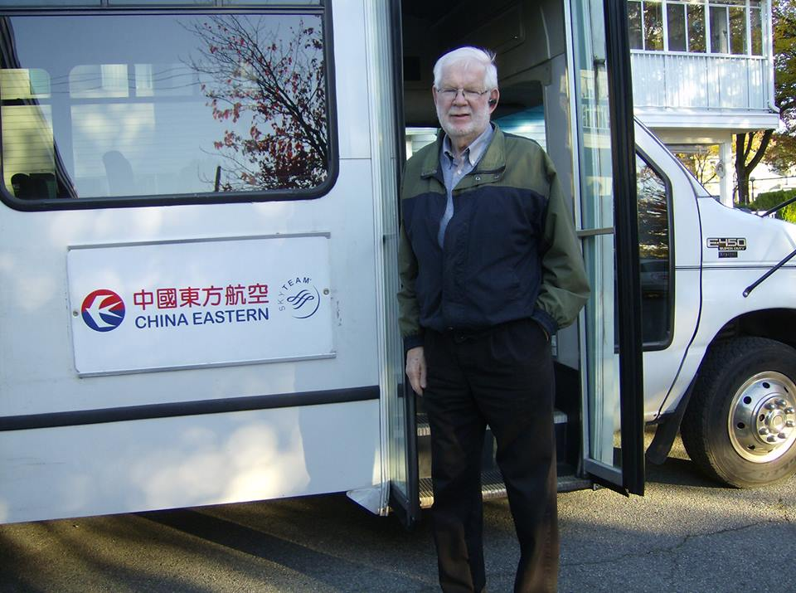
Personal Stories

Slide 20
Day after day, in the temple courts and from house to house, they never stopped teaching and proclaiming the good news that Jesus is the Messiah. Acts 5:42 (NIV)

Slide 21
The Evangelists
Evangelists are characterized by a keen desire to tell the gospel to others.
Evangelists relate well to those who do not yet believe.
Evangelists are mature Christians who display self-control, honesty and commitment to the truth.
Evangelists are clear with the gospel and its demands.

Slide 22
The Informal Evangelists

Slide 23
Preparation
1 Peter 3:15 (NIV)
¹⁵ But in your hearts revere Christ as Lord. Always be prepared to give an answer to everyone who asks you to give the reason for the hope that you have. But do this with gentleness and respect

Slide 24
Preparation
Rehearse God’s Big Story
Rehearse Jesus’ Story
Rehearse Your Story

Slide 25
God’s Big Story
Background beliefs about the God of creation.
Convictions about the uniqueness of human beings as image bearers of God.
A diagnosis of what has gone wrong with the world.
God’s interventions to restore justice, mercy and peace.
A vision for the future.
A way of living today.

Slide 26
Jesus’ Story
The gospels are the Gospel.
Matthew, Mark, Luke, John
Apostolic Preaching in Acts
Acts 2:14-39
Acts 3:12-26
Acts 4:8-12
Acts 10:34-43, with 11:4-18
Acts 13:16-41
Acts 14:15-17
Acts 17:22-31
Gospel Summaries in Epistles
Romans 1:1-6
1 Corinthians 15:1-8, 20-28
Colossians 1:15-23
2 Timothy 2:8-9
Gospel Summary in Revelation
Revelation 14:6-7

Slide 27
Your Story
“We live in a society where a testimony from our friend carries as much weight as one from a so-called professional. For example, in buying a car many of us will ask our friends what they like and dislike about their vehicle. We trust what they are telling us to be true and will often make a decision based upon their testimony.”
(Henry Knight and Douglas Powe, Transforming Evangelism)

Slide 28
Activity
On a piece of paper draw a timeline (from birth to your current age) down the left-hand side of the page.
Write down (in rough chronological order) every key moment on your Journey of Grace. (when people prayed for you, when you heard about Jesus, when you met a Christian who influenced you, significant moments of insight or understanding, moments of crisis, significant moments of decision, etc…)
Now select three or more of most important points on the time-line and put a “star” next to them.
Identify two or three key people who journeyed with you to these important points and briefly describe how they did so.
Include two or three Scriptures that meaningfully connect your story to Jesus’ story.
Take turns. Share your personal story, emphasising the events, people and Scripture that contributed to your present faith in Jesus Christ.
Offer encouragement and positive feedback as well as ideas for further development of your story.

Slide 29
A
JOURNEY
OF GRACE

Slide 30
WHAT IS OUR PART ON THE JOURNEY OF GRACE WITH OTHERS?

Slide 31
A Journey of Grace
Personal Prayer
Personal Stories
Personal Journey

Slide 32
Personal Journey
As they traveled along the road, they came to some water and the eunuch said, "Look, here is water. Why shouldn't I be baptized?“ (Acts 8:36)

Slide 33
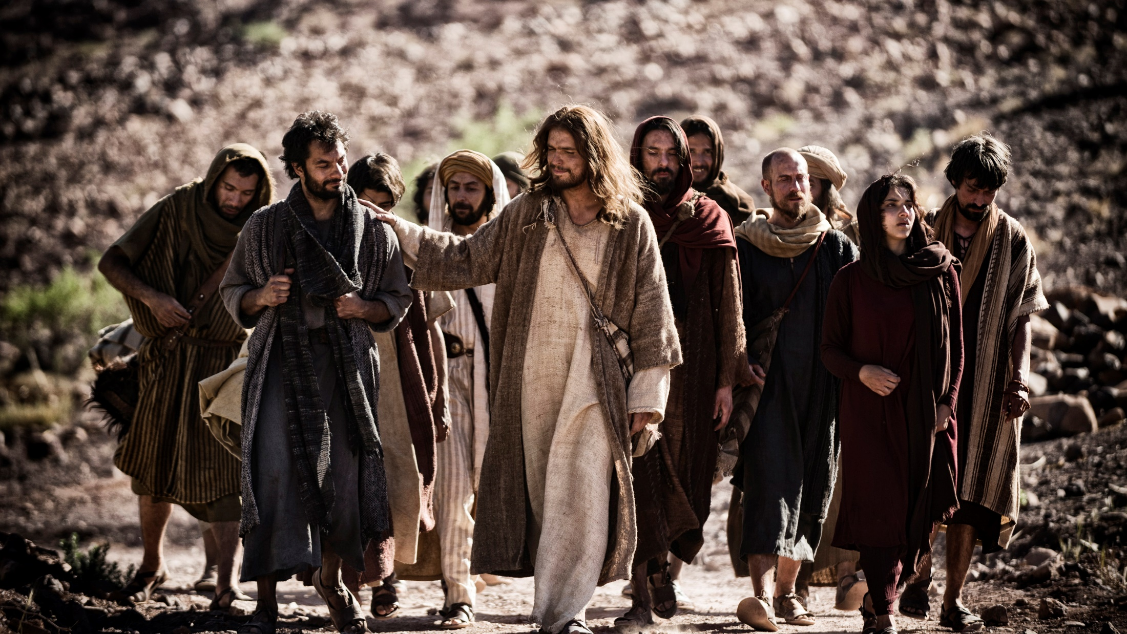
Personal Journey
“Jesus actually spent more time with his disciples than with everybody else in the world put together.”
Robert Coleman, The Master Plan of Evangelism

Slide 34
Personal Journey
“Most of the time, initiation into the Christian life takes a lot of time.”
Scott J Jones, The Evangelistic Love of God and Neighbor: A Theology of Witness and Discipleship

Slide 35
Personal Journey

Slide 36
Personal Journey

Slide 37
Personal Journey
“While it is true that spiritual pilgrimage is neatly defined for some people, the search for God is much messier for most.”
Richard Peace, Conversion in the New Testament

Slide 38
Breakout Room - Discussion
Who walked the Journey of Grace with you?
What are some of the ways that people were helpful to you on your Journey of Grace?
Who are you walking the Journey of Grace with?
What is one thing you can do this week to help this person on their Journey of Grace?

Slide 39
FROM GRACE
TO GRACE
TO GRACE

