Slide 1





RELATIOMAL
MENTORSHIP STRATEGIES
Mtra. Annette y
Mtro. Tim Gulick

Slide 2

Mentoring Check-in

Slide 3

Session 1:
The Mentoring Pathway

Slide 4

Session 2:
Managing Expectations in the Mentoring Relationship

Slide 5
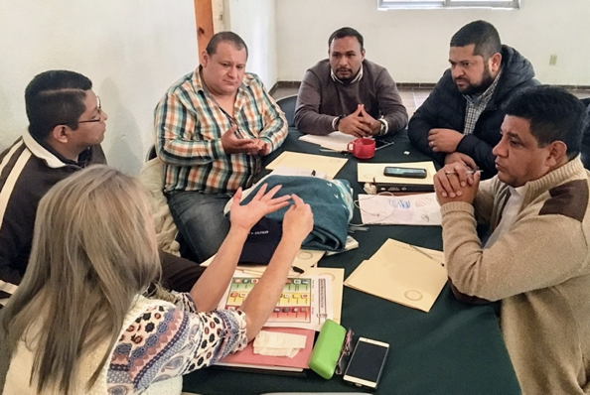

The Mentoring Pathway
Connect: Mentoring Check-in

Slide 6

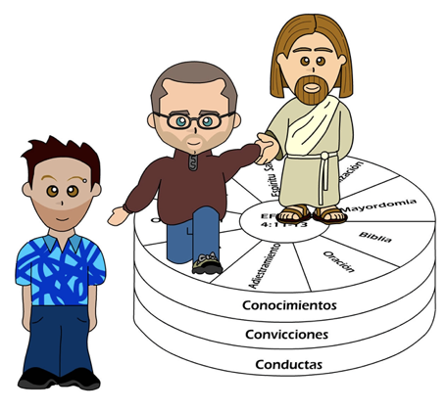
Content: The Mentoring Pathway

Slide 7

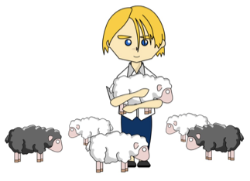
The Mentoring Pathway
1. Be a model of what you seek

Slide 8


The Mentoring Pathway
2. Have contact with a wide variety of people

Slide 9

The Mentoring Pathway
3. Pray

Slide 10


The Mentoring Pathway
4. Select and invite a few people

Slide 11


The Mentoring Pathway
5. Make their personal and ministerial development a top priority for your ministry

Slide 12
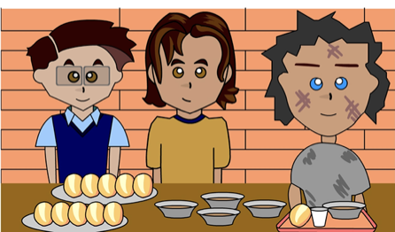
The Mentoring Pathway
6. Delegate responsibility
gradually & progressively

Slide 13
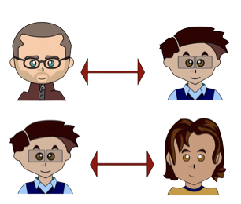
The Mentoring Pathway
7. Recruit new people to mentor & support the people you have mentored as they mentor others

Slide 14



Challenge:
Personalizing the Mentoring Pathway

Slide 15
Change: Questions, Comments, and Takeaway

Slide 16
Managing Expectations in the Mentoring Relationship

Slide 17
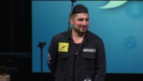
Connect: A Mentoring Case Study

Slide 18
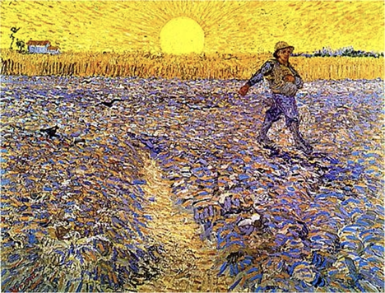
Content:
Jesus’ Relationships
and Their Results

Slide 19

Rich
Young
Ruler
Photo by Michael Belk

Slide 20
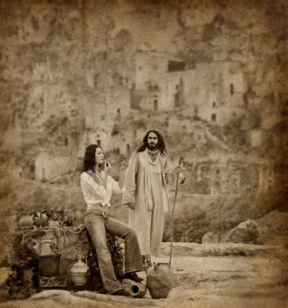
The Samaritan Woman
Photo by Michael Belk

Slide 21
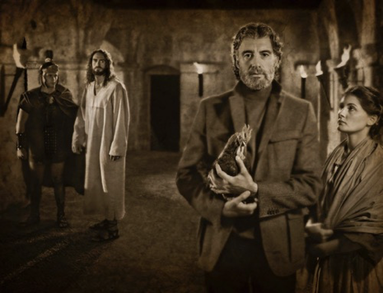
Peter
Photo by Michael Belk

Slide 22
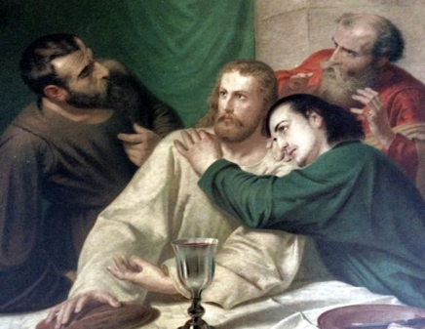
John
The Last Supper by Adolf Schmitz

Slide 23
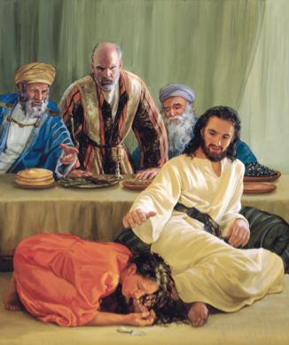
Judas

Slide 24
Challenge:
Lessons
Learned
from Jesus

Slide 25
Change:
My Lessons
Learned

Slide 26
Jesus, Our Model
of Relational Ministry in Mentoring
Tim & Annette Gulick
OC International / SEPAL

