Slide 1
Special
Evangelism
Breaking Barriers
Importance of the Teacher
Characteristics of the Teacher

Slide 2
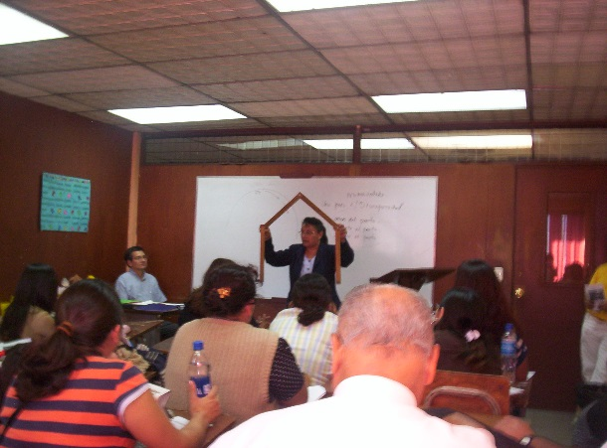
BREAKING BARRIERS
Mark 2:1-12
How can we break the barriers?
Following Christ´s example. (v.1,2)
Looking for alternatives. (v. 3, 5)
Overcoming the enemy. (v. 12)

Slide 3
THE IMPORTANCE OF THE TEACHER
Their identity
It is one who, through the process of teaching-learning the word of God, produces changes in their own life as well as the lives of their students.

Slide 4
It is the one who guides others in the discovery of truth, winning each student for Christ.
It is the one who helps others to learn, guiding each student in the study of the Bible.
It is the one who instills life &
doesn´t just pass on knowledge

Slide 5
Their importance
Their influence (Words, actions and personality) Philippians 4:9
The teacher is formed through their experience with God.

Slide 6
Their calling
The teacher should pray and ask that God show them his will.
The teacher´s trust should be only in the Lord.
The Lord is looking for people who are willing to serve Him.
2 Timothy 2:2

Slide 7
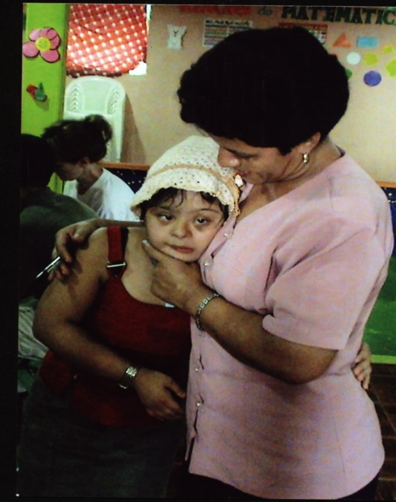
THEIR TASK
To pray that God give them wisdom as they prepare the class and to pray for their students.
To study the material (Bible lesson, verses, song, etc.) ahead of time.

Slide 8
To first apply the teaching to their own life, giving an example of how the word of God transforms.
To teach, that is, to share the planned lesson. Esther 7:10

Slide 9
To teach the word of God in such a way that each student recognizes their need for Christ, learns to live a life of holiness by faith, knows to apply the promises of God and to serve Him. Colossians 1:28
The biggest mission that God gives to us as his children is to place his Word in our hands and to call us “Teachers.”

Slide 10
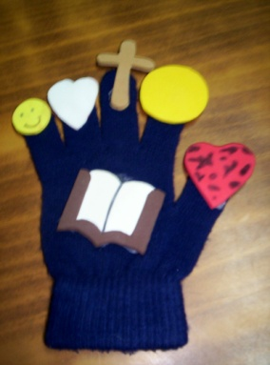
How to share the plan of salvation
It is important to be aware that the student is lost without Christ and that we are able to guide them in the correct way. Presenting the salvation message:
Who is God? His love.
The problem / need - Sin
The solution / way - The person and work of Christ.
The appropriation / invitation - Receive Christ.

Slide 11
Characteristics of an Evangelistic Teacher.
Must trust in Jesus as Lord and Savior.
Must follow Christ´s example.
Must know and understand the people they will be teaching.
Must know the biblical plan of salvation and be able to explain it.

Slide 12
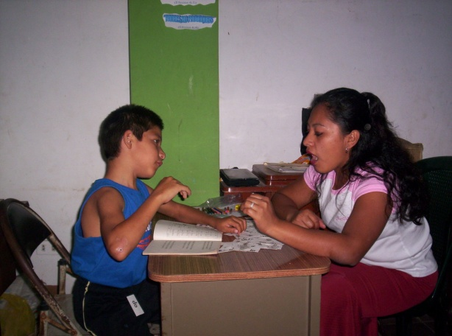
Approach, love ,patience

