Slide 2
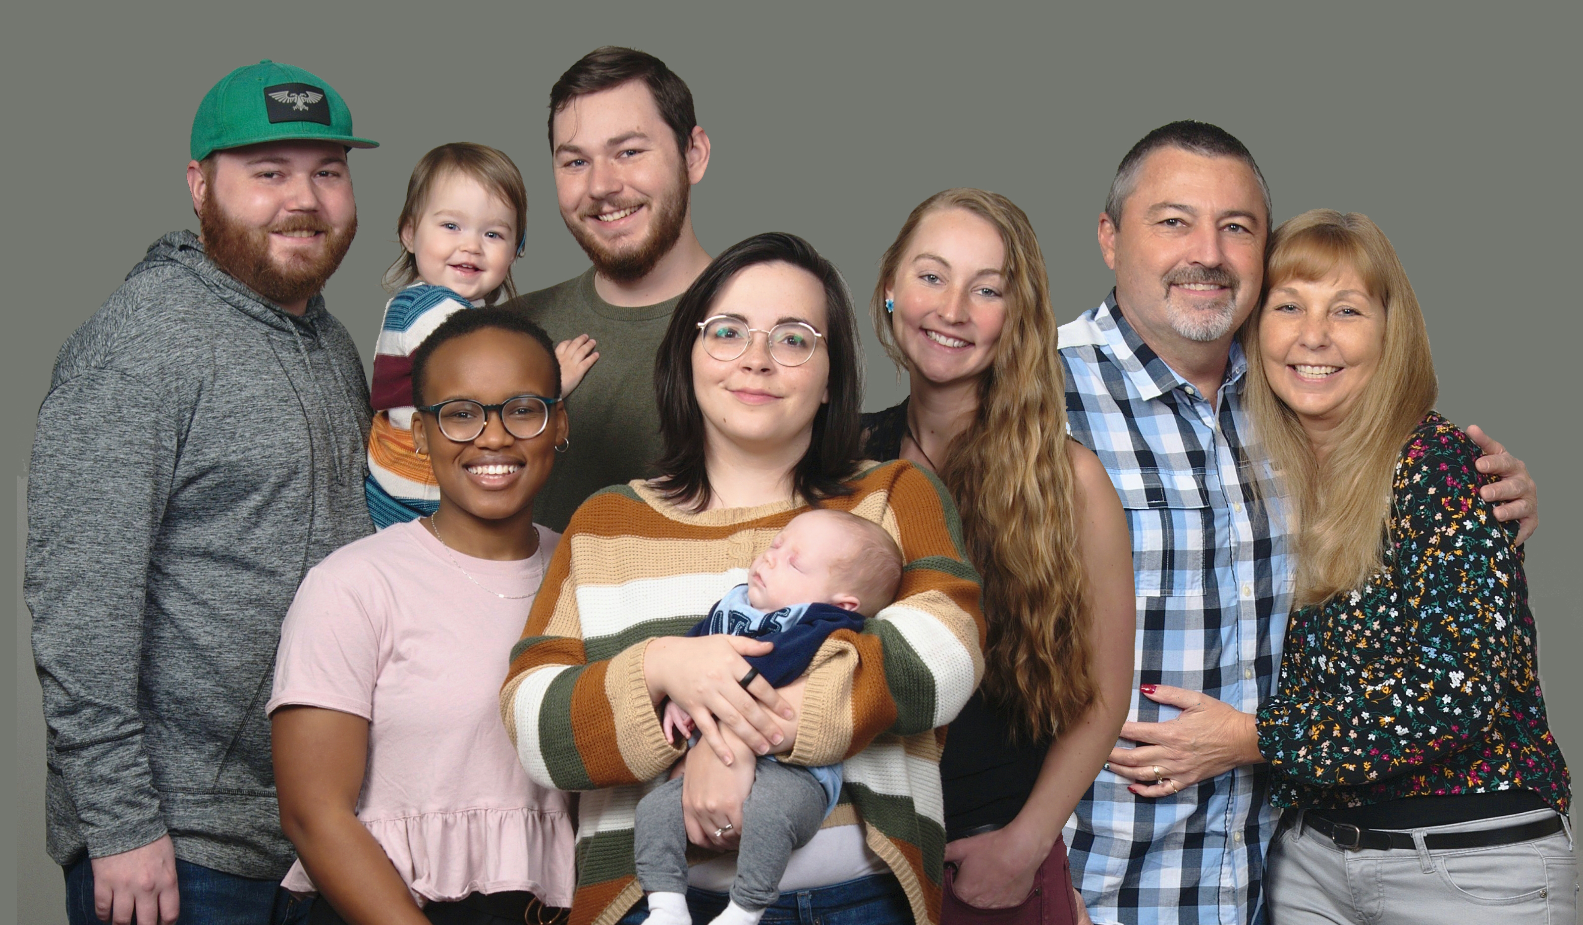

Slide 3
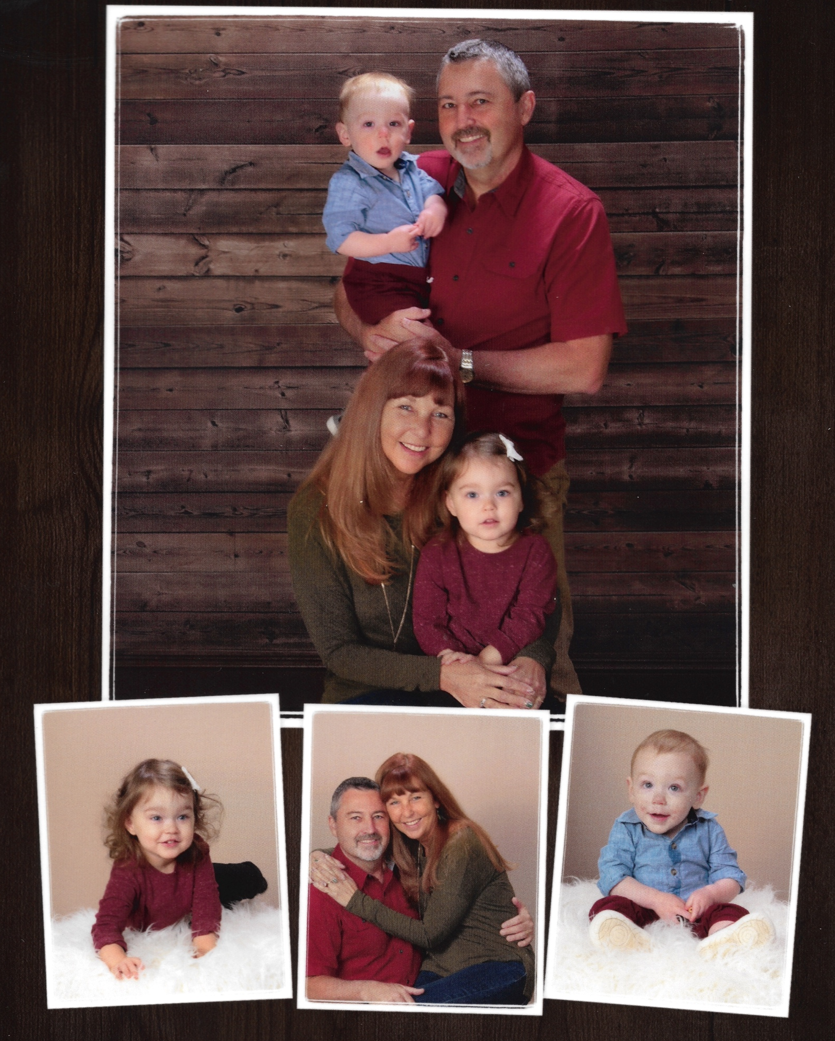

Slide 4
Million Leaders Mandate Notebook 6
Today Matters:
Leadership and Personal Growth
(Lesson 1)

Slide 5
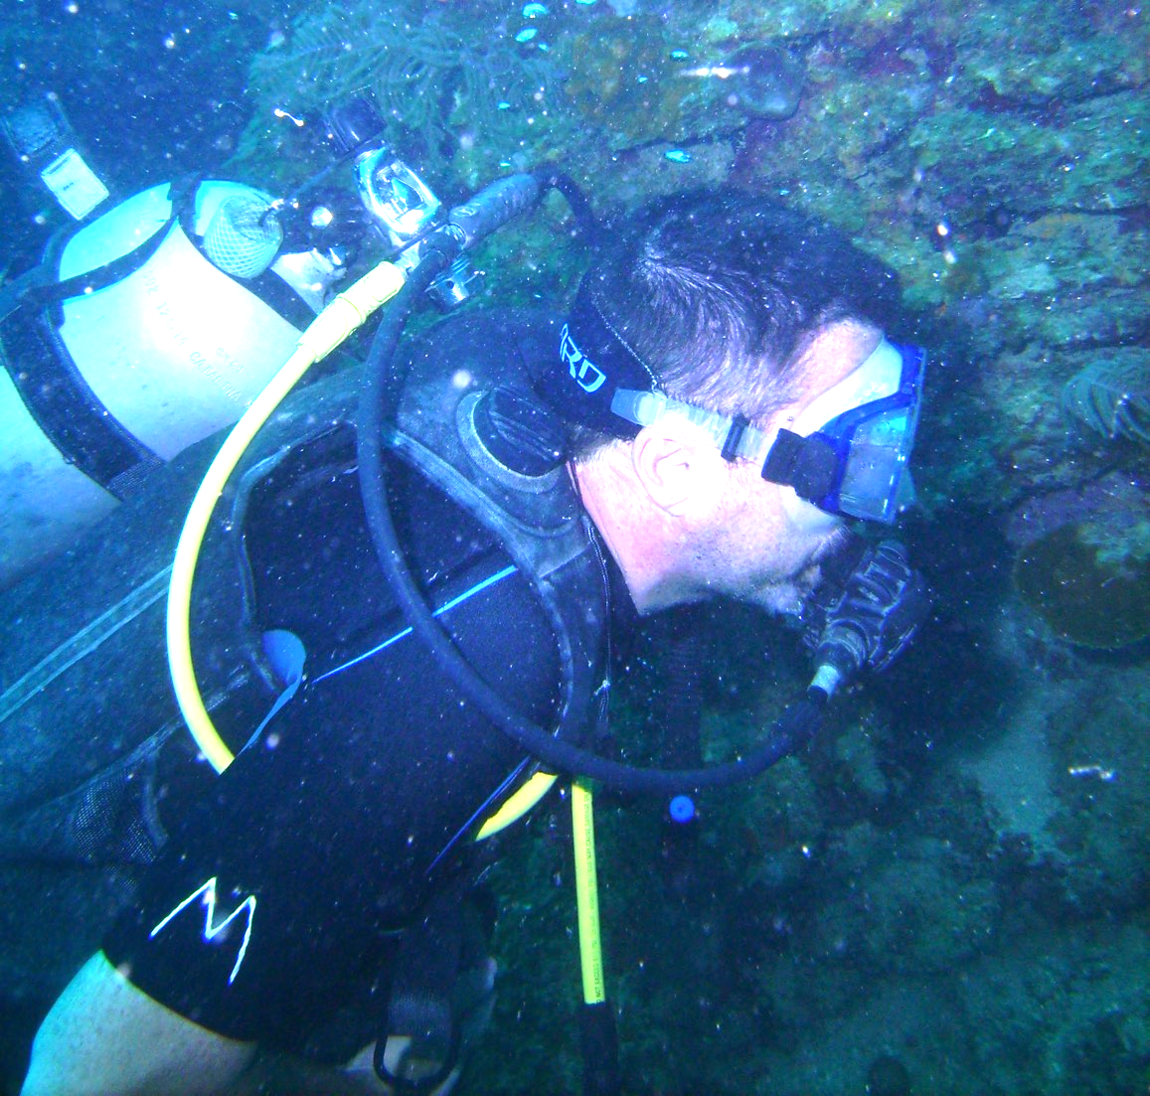

Slide 6
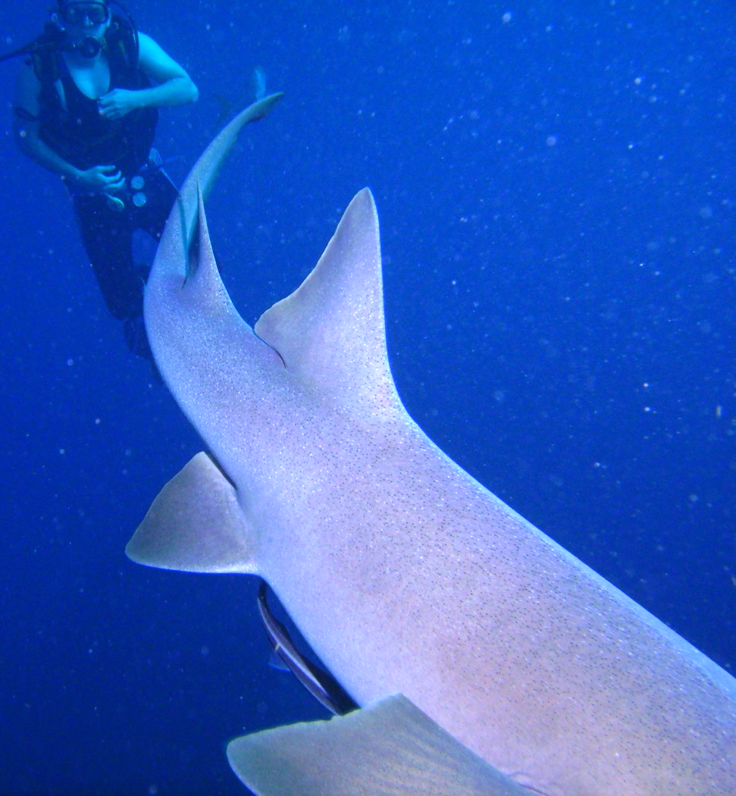

Slide 7
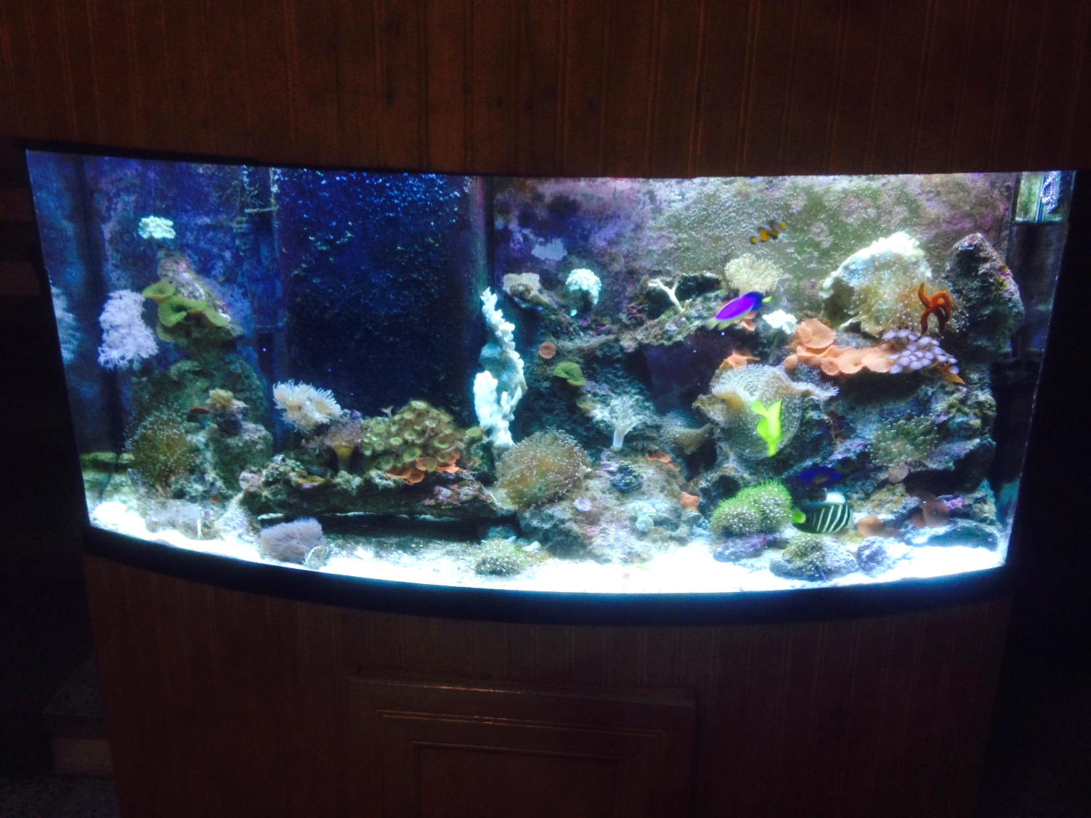

Slide 8
“One today is worth two tomorrows; what I am to be, I am now becoming.”
Benjamín Franklin

Slide 9
"I forgot that every little action of the common day makes or breaks my character …”
- Oscar Wilde

Slide 10
Key Principle
Successful people make right DECISIONS early in life and MANAGE those decisions daily.

Slide 11
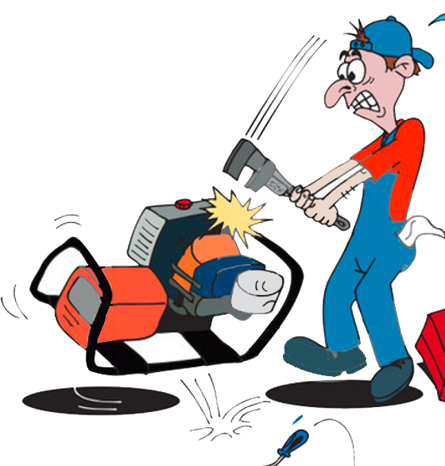
Do you want to
invest time PREPARING,
or spend time REPAIRING?

Slide 13
Preparing or Repairing
Preparing | Repairing
1. Allows you to focus on today and tomorrow | 1. Makes you focus on yesterday
2. Increases efficiency | 2. Consumes time
3. Increases confidence | 3. Breeds discouragement
4. Saves money | 4. Increases costs
5. Pays now for tomorrow | 5. Pays now for yesterday
6. Takes you to a higher growth level | 6. Becomes an obstacle for growth

Slide 14
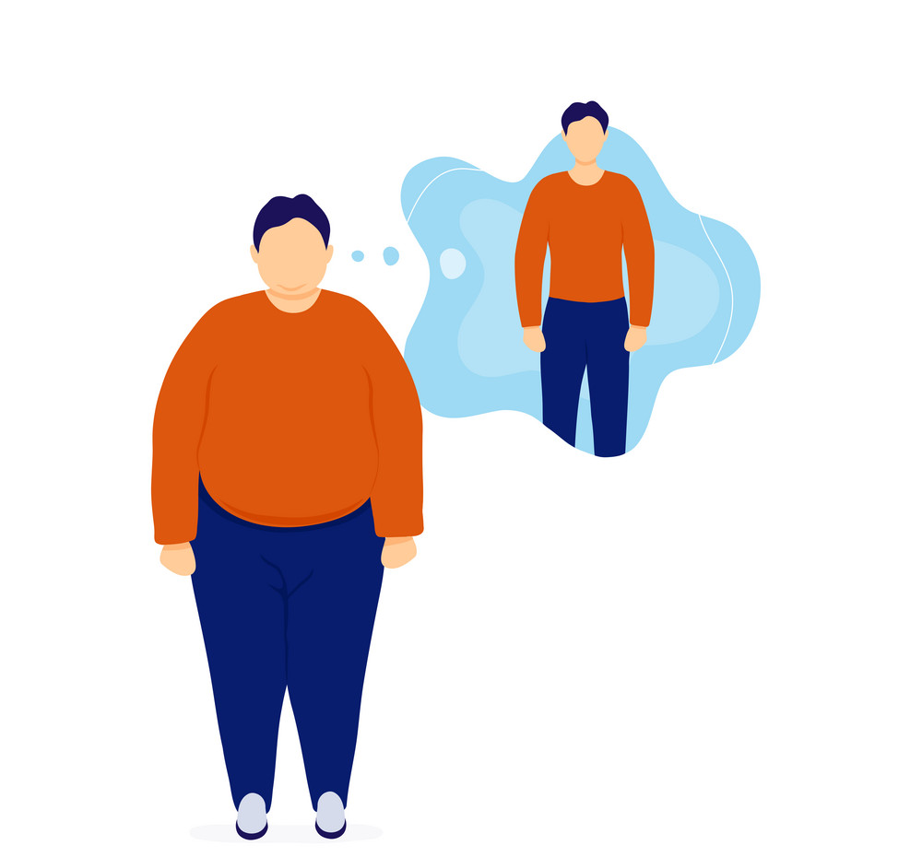
Decisions & Discipline:
Good decisions (plans) without daily discipline equals:
A PLAN WITHOUT A PAYOFF.

Slide 15
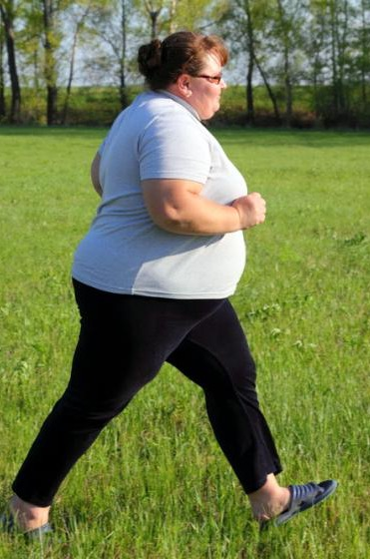
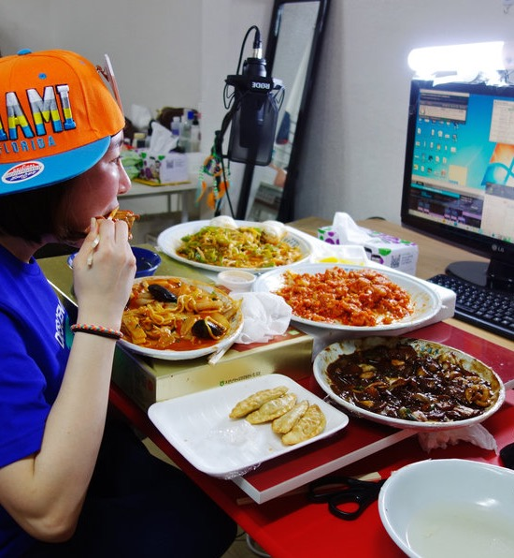
Decisions & Discipline:
Daily discipline without good decisions equals:
A REGIMENT (WORK) WITHOUT A REWARD.

Slide 16
Decisions & Discipline:
Good decisions combined with daily discipline equals:
A MASTERPIECE OF POTENTIAL.

Slide 17
Twelve Important Decisions to Make and Manage for Personal Growth
1. ATTITUDE: Choose to display the right attitudes daily.
Leadership Truth: Today's attitude gives me possibilities.

Slide 18
1. ATTITUDE: Choose to display the right attitudes daily.
My attitude as I begin a task affects its outcome more than anything else.

Slide 19
1. ATTITUDE: Choose to display the right attitudes daily.
My attitude towards others often determines their attitude towards me.

Slide 20
1. ATTITUDE: Choose to display the right attitudes daily.
My attitude, not my achievements, gives me happiness.

Slide 21
1. ATTITUDE: Choose to display the right attitudes daily.
My attitude – good or bad – is contagious.

Slide 23
NEVER GIVE UP

Slide 24
ATTITUDE
Personal assessment
Where is it most difficult for you to keep a positive attitude?
What is one step you could take to improve your attitude?

Slide 25
Twelve Important Decisions …
2. PRIORITIES: Determine and act upon important priorities daily.
Leadership Truth: Today's priorities give me focus.

Slide 26
2. PRIORITIES: Determine and act upon important priorities daily.
Time is our most precious commodity.
We cannot manage time, we only manage opportunities.
We cannot change time, only our priorities.
Priorities help us choose wisely.

Slide 27
Every time that you say “Yes” to something, you must say “No” to something else.

Slide 28
PRIORITIES
Personal assessment
What are your top three - five most important priorities?
Do you stick to them?

Slide 29
Twelve Important Decision …
3. HEALTH: Know and follow healthy guidelines daily.
Leadership Truth: Today's health gives me strength.

Slide 30
3. HEALTH: Know and follow healthy guidelines daily. .
Lasting leaders recognize their body is a vehicle that carries them to their mission.

Slide 31
3. HEALTH: Know and follow healthy guidelines daily.
Proper diet and exercise provide the energy to lead well over the long haul.

Slide 32
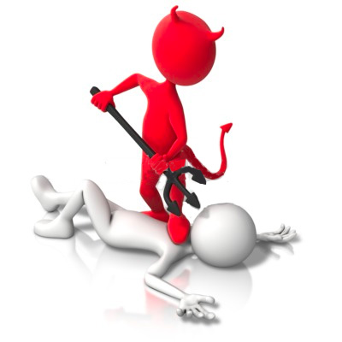
3. HEALTH: Know and follow healthy guidelines daily.
Your physical health will impact your spiritual stamina and perspective.

Slide 33
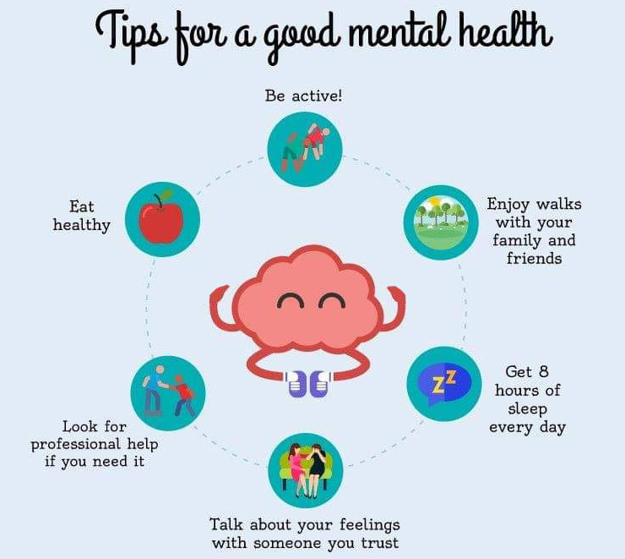
3. HEALTH: Know and follow healthy guidelines daily.
Mental health is a crucial but often overlooked component of your overall health.

Slide 34
HEALTH
Personal assessment
Rate your diet, your exercise, and your rest.
Are you healthy? What changes do you need to make?

Slide 35
Twelve Important Decisions …
4. FAMILY: Communicate with and care for my family daily.
Leadership Truth: Today's family gives me stability.

Slide 36
4. FAMILY: Communicate with and care for my family daily.
Families are often lost – spent as the price for successful ministries.
If we cannot lead our homes, we cannot expect to lead the Church. (1 Tim. 3:4-5)

Slide 37
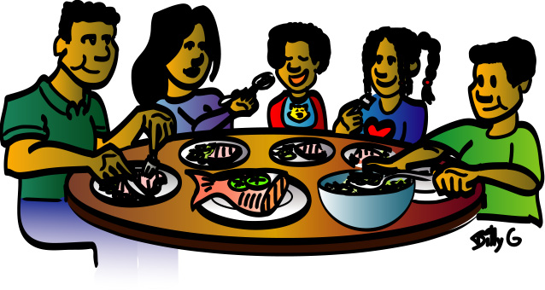
4. FAMILY: Communicate with and care for my family daily.
Success is having those closest to me, love and respect me the most.
Families are like gardens; they must be cultivated and watered regularly.

Slide 38
Values that foster healthy family relationships include:
1) commitment to God
2) continual growth
3) common experiences
4) confidence in each other and the Lord
5) making a contribution to life together.

Slide 39
Even with these in place, balancing work and family life is a challenge!
As leaders, we must…
Put our family on the calendar first.
Find ways to spend time together.
Express appreciation for each other.
Be honest and resolve conflict as quickly as possible.

Slide 40
FAMILY
Personal assessment
How do you demonstrate that your family is a top priority?

Slide 41
Twelve Important Decisions …
5. THINKING: Practice and develop good thinking daily.
Leadership Truth: Today's thinking gives me an advantage.

Slide 42
5. THINKING: Practice and develop good thinking daily.
A major difference between successful and unsuccessful people is how they think.
God is the original Source of creative ideas, and He has made us in His image.
All that a person achieves or fails to achieve is the direct result of their thoughts.

Slide 43
Thinking Skills Of Effective People:
Big Picture Thinking: ability to think beyond yourself and your world
Focused Thinking: ability to think with clarity by removing distractions / clutter
Creative Thinking: ability to break out of your "box" and explore new ideas
Realistic Thinking: ability to build a solid foundation on facts and reality
Strategic Thinking: ability to implement plans that increase potential tomorrow

Slide 44
Thinking Skills Of Effective People:
Possibility Thinking: ability to unleash enthusiasm / hope to solve the impossible
Reflective Thinking: ability to revisit the past and gain perspective
Questioning Popular Thinking: ability to reject common thinking; gain new ideas
Shared Thinking: ability to include others to go beyond your own thoughts
Unselfish Thinking: ability to consider others, and to think with collaboration
Bottom-line Thinking: ability to focus on results and reap the best rewards

Slide 45
THINKING
Personal assessment
Do you have a place and time to simply sit and think?
Where and when do you do your best thinking?

Slide 46
Twelve Important Decisions …
6. COMMITMENT: Make and keep proper commitments daily.
Leadership Truth: Today's commitment gives me tenacity.

Slide 47
6. COMMITMENT: Make and keep proper commitments daily.
Why Commitment Matters Today:
Commitment can change your life. (Most life changes are connected to decisions.)
Commitment helps you overcome many of life’s obstacles.
Every day your commitment will be tested.

Slide 48
Twelve Important Decisions …
"When you're interested in something, you do it only when it's convenient. When you're committed to something, you accept no excuses, only results.”
Ken Blanchard

Slide 49
COMMITMENT
Personal assessment
What are the top three commitments of your life?
How could you deepen your commitment in those areas?

Slide 50
Twelve Important Decisions …
7. FINANCES: Make and properly manage money daily.
Leadership Truth: Today's finances give me options.

Slide 51
7. FINANCES: Make and properly manage money daily.
Three simple truths about finances:
a. Money won't make you happy.
b. Debt will make you unhappy.
c. Having financial margins give you options.

Slide 52
Twelve Important Decisions …
John Wesley's Rule for Money:
Earn all you can,
Save all you can
Give all you can.

Slide 53
FINANCES
Personal assessment
How does your spending reveal what's in your heart?
What changes should you make in where your money goes?

Slide 54
Twelve Important Decisions …
8. FAITH: Deepen and live out my faith daily.
Leadership Truth: Today's faith gives me peace.

Slide 55
8. FAITH: Deepen and live out my faith daily.
a. Faith gives me divine perspective today.
b. Faith gives me strength for today.
c. Faith gives me resilience today.

Slide 56
Where there is no faith in the future, there is no power in the present.

Slide 57
FAITH
Personal assessment
As a leader, do I model strong faith?
How can I grow in my faith?

Slide 58
Twelve Important Decisions …
9. RELATIONSHIPS: Initiate and invest in solid relationships daily.
Leadership Truth: Today's relationships give me fulfillment.

Slide 59
9. RELATIONSHIPS: Initiate and invest in solid relationships daily.
You'll enjoy life more if you enjoy people.
You'll get further in life if people enjoy you.
Most people can trace their successes and failures to the relationships in their life.

Slide 60
RELATIONSHIPS
Personal assessment
Do I experience healthy, close relationships?
Or do I isolate myself and withdraw from them as a leader?

Slide 61
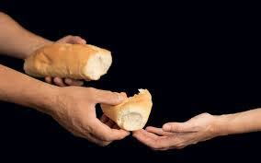
Twelve Important Decisions …
10. GENEROSITY: Plan for and model generosity daily.
Leadership Truth: Today's generosity gives me significance.

Slide 62
10. GENEROSITY: Plan for and model generosity daily.
a. Giving turns your focus outward.
b. Giving adds value to others.
c. Giving helps the giver.

Slide 63
King Solomon said: “The world of the generous gets larger and larger; the world of the stingy gets smaller and smaller. The one who blesses others is abundantly blessed; those who help others are helped.”

Slide 64
GENEROSITY
Personal assessment
Do others see me as a generous person?
How can I increase my generosity?

Slide 65
Twelve Important Decisions …
11. VALUES: Embrace and practice good values daily.
Leadership Truth: Today's values give me direction.

Slide 66
11. VALUES: Embrace and practice good values daily.
My values function as:
An anchor-holding me fast to what I believe in and know to be true.

Slide 67
11. VALUES: Embrace and practice good values daily.
My values function as:
A faithful friend-keeping me true to myself and to my God.

Slide 68
11. VALUES: Embrace and practice good values daily.
My values function as:
A north star-guiding the decisions of my life and keeping me on mission.

Slide 69
VALUES
Personal assessment
What are your personal core values?
Your family's?
Your church's?

Slide 70
Twelve Important Decisions …
12. GROWTH: Seek and experience improvements daily.
Leadership Truth: Today's growth gives me potential.

Slide 71
GROWTH
"Hell begins on that day when God reveals all that we might have achieved, all the gifts we wasted and all that we might have done that we did not do."
Gian Menotti

Slide 72
12. GROWTH: Seek and experience improvements daily..
MISCONCEPTIONS about Personal Growth:
Growth is automatic.
Growth comes with experience.
Growth comes from information.

Slide 73
GROWTH
“The greatest gap in life is the one between knowing and doing.”
Dick Biggs

Slide 74
Key Principle
Successful people make right DECISIONS and MANAGE those decisions daily.

Slide 75
Twelve Important Decisions to Manage for Personal Growth
ATTITUDE
PRIORITIES
HEALTH
FAMILY
THOUGHTS
COMMITTMENT
FINANCES
FAITH
RELATIONSHIPS
GENEROSITY
VALUES
GROWTH

Slide 76
GROWTH
Personal assessment
In which of these twelve areas are you growing?
Which ones are weak?
What is one step you could take to grow in each of these twelve important areas?

Slide 77
QUESTIONS
OR
COMMENTS?
Answers on page 8

