Slide 2
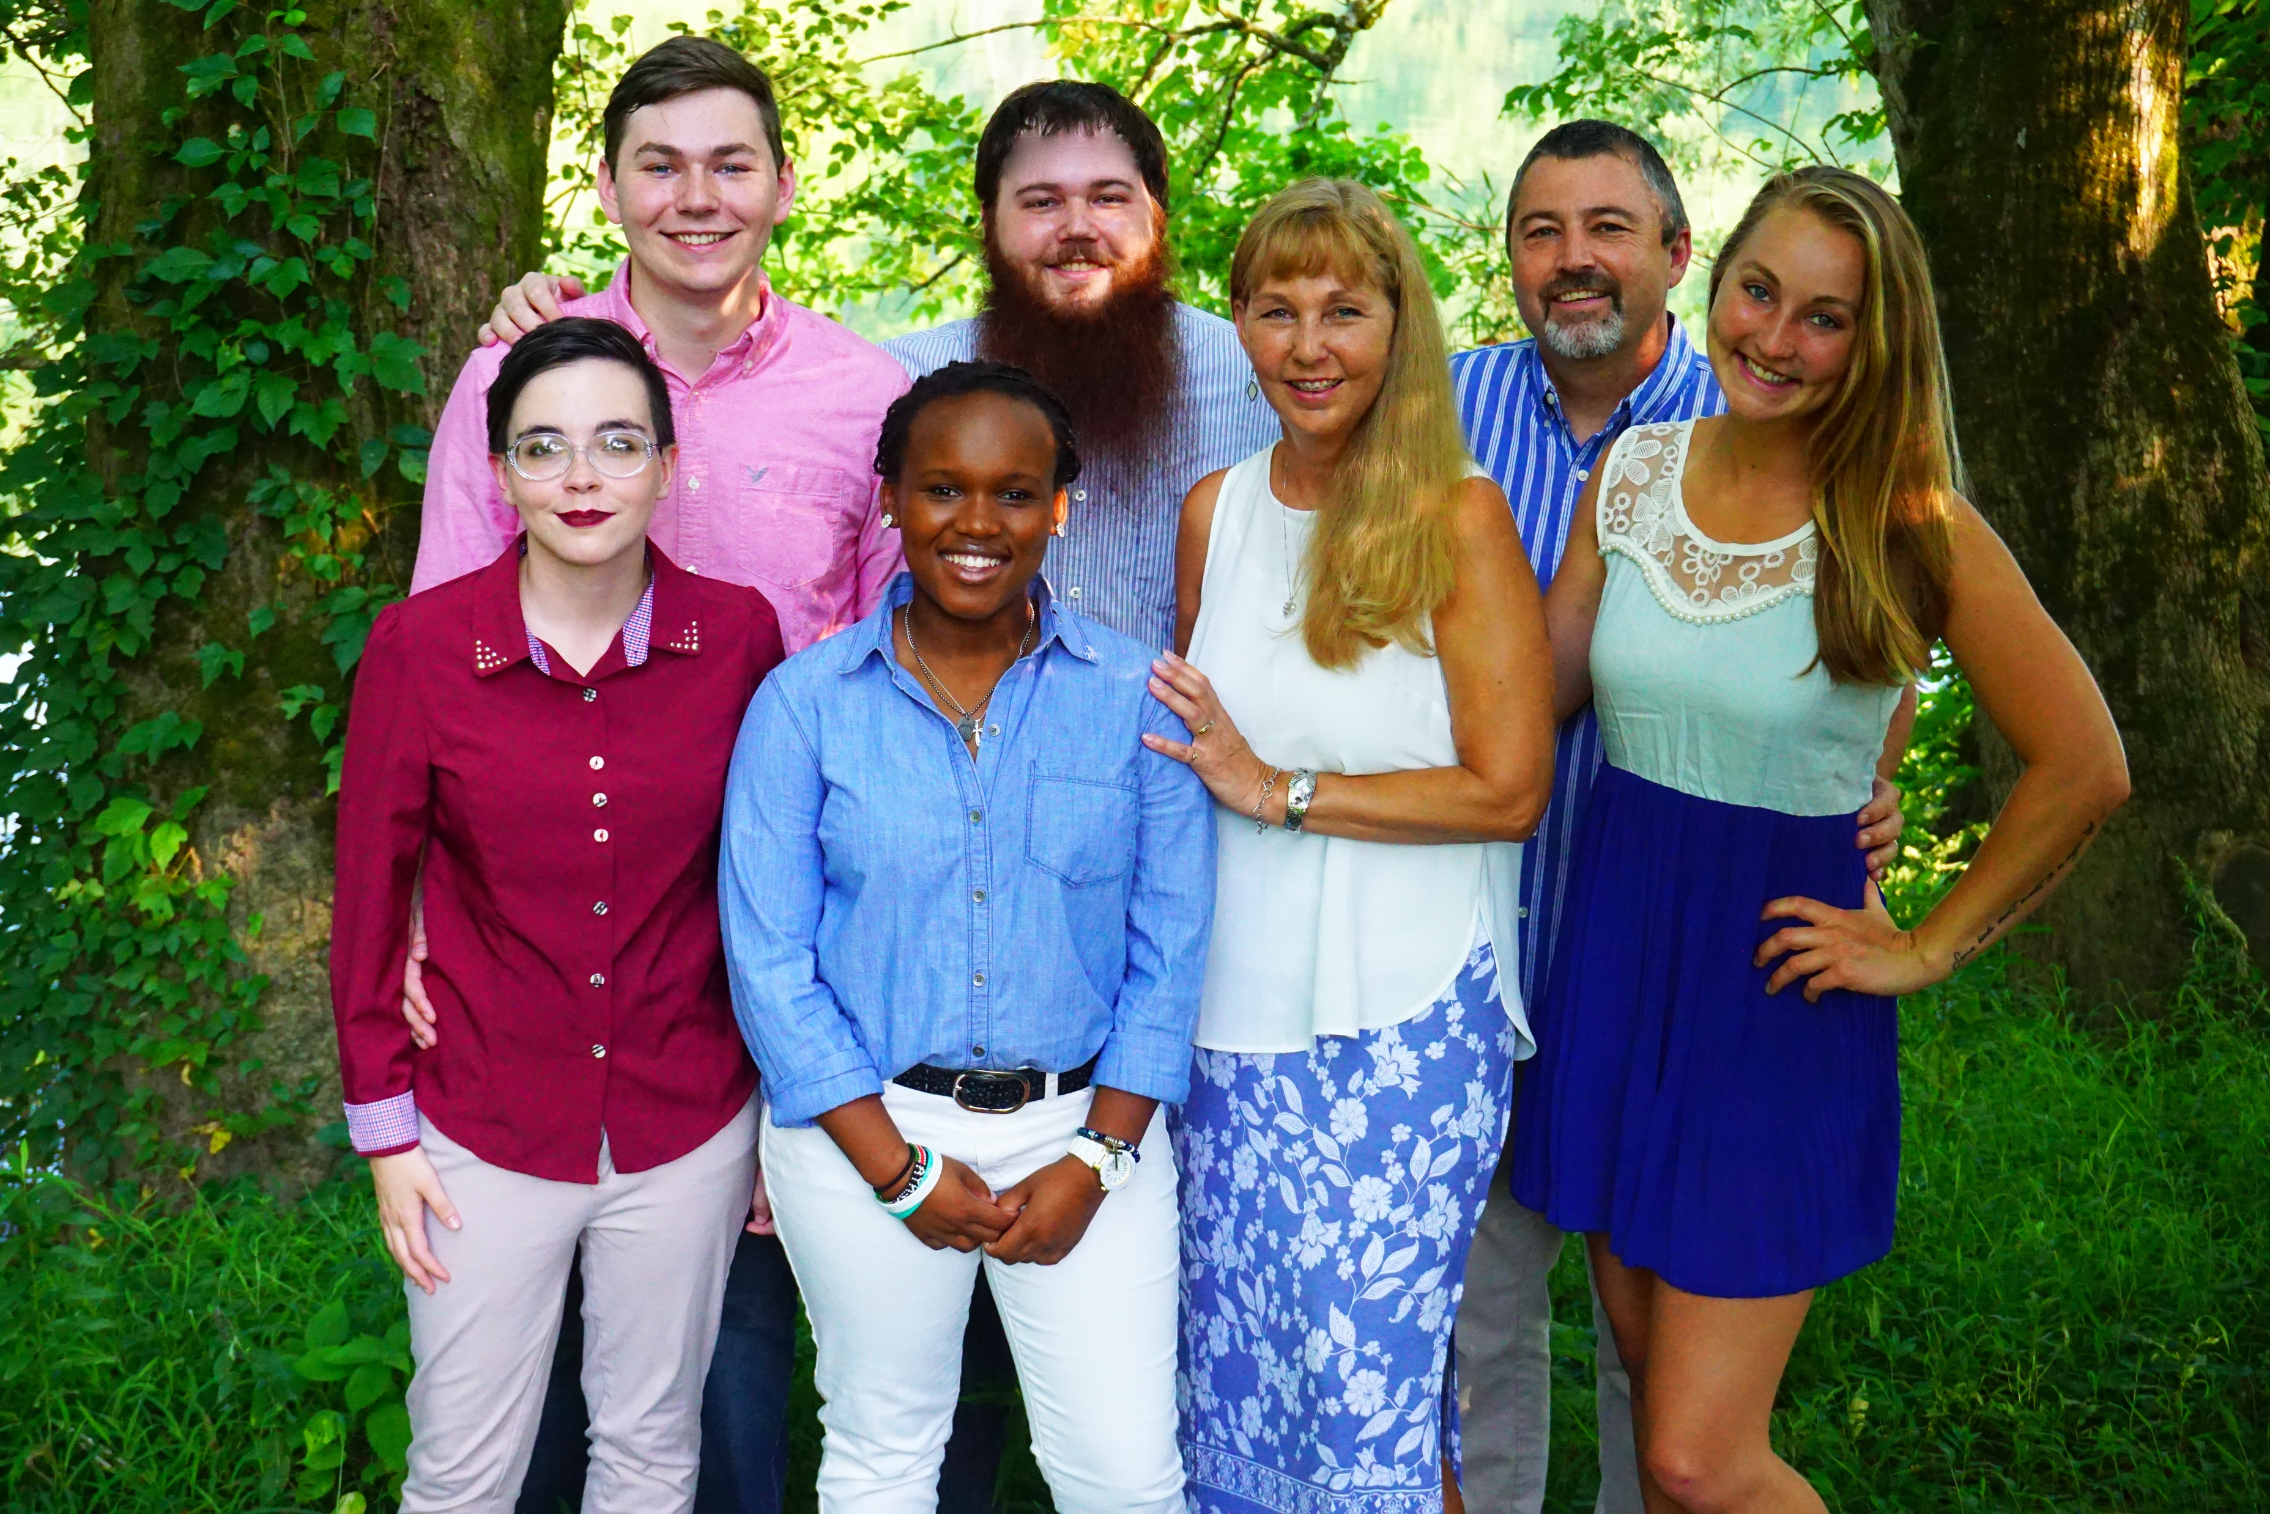

Slide 3
Million Leaders Mandate
Notebook Five
The Foundation for Our Leadership Our Ministry Will Be a Precious Treasure or a Performance Trap
(Lesson 1)

Slide 4
Connect all of the dots using 4 straight lines. You cannot lift your pencil from the paper.

Slide 9
Two Common Drives that emerge when people meet Jesus:
1. We are driven to GET CLOSE TO HIM.
2. We are driven to GET BUSY FOR HIM.
Luke 10:38-42 – Mary & Martha

Slide 10
Our Problem
COMPETENCE | COMMUNION
Thrives on rules and routines
2. Acts out of duty
3. Motivation: guilt
Human Obligation
5. Comparison to others
6. Tired performance
Thrives on relationship
2. Acts out of devotion
3. Motivation: gratitude
Divine grace
5. Acceptance of others
6. Empowered service

Slide 11
Performance vs. Service
Performance = Ministry done out of human OBLIGATION, contrived from human strength in order to gain the approval of someone.
Service = Ministry done out of an experience of GRACE. It is a loving response to a new identity in order to say thank you to God.

Slide 12
Ask Yourself These Questions
What is the foundation for my ministry?
Why do I do what I do?
What do I seek from doing ministry?

Slide 13
Differences Between Leadership based on Performance or Service
Performance (Law) | Service (Grace)
Strives in human strength
Bondage to law and legalism
Imbalance: More doing than being
Motive is to please people
Comparison w/others
Acknowledges human weakness; waits on God’s strength & timing
Freedom to give out of devotion, not duty
3. Balanced rhythm of reflection and obedience
Ability to say no to people at God’s Direction
Acceptance of others

Slide 14
Differences Between Leadership
Performance (Law) | Service (Grace)
Manipulates and controls others
Lack of joy and peace
Extreme reactions
Frustration with self
Freedom to make choices and be different
Experiences the fruit of the Spirit
Consistency, stability; sensitive to God’s Leading
Acceptance of God’s growth process in self

Slide 15
Differences Between Leadership
Performance (Law) | Service (Grace)
10. Relationship with God is unstable
Works to gain God’s approval
Produces stronghold of religion
10. Slow but steady growth with God
Natural life-response to
God’s unconditional approval
Produces deep relationship with God

Slide 16
The power to BE is a priority over the power to DO, because if you are SOMEBODY, you will naturally do SOMETHING!

Slide 17
Conclusions Regarding Our Problem
Our ministry must move from PERFORMANCE to SERVICE.
We must pursue COMMUNION before COMPETENCE.
We cannot be GRACE-GIVERS until we are GRACE-RECEIVERS.

Slide 18
Our Potential
The Picture of a Father and Son
We are first a CHILD of God before we are a WORKER for God.
The Picture of a Marriage
We are the BRIDE of Christ before we are SLAVES to Christ.
The Picture of an Ambassador
We operate in GOD’S power and authority, not our OWN.

Slide 19
The Biblical Basis for a Grace Empowered Ministry
• II Corinthians 9:8
• II Corinthians 12:9
• Ephesians 2:10
• I Corinthians 15:10
It isn’t that the law is bad; it just doesn’t give us any power to live a life of service and ministry. It can only remind us when we’ve failed. Grace changes our desires & empowers us to live out those desires.

Slide 20
Our Prescription
Our “Mary” experience should precede our “Martha” experience.
Our competence should come from our communion with God.
We must find a balanced rhythm of being and doing.
We must believe and embrace the following “grace” foundations.

Slide 21
Grace Foundations
God’s grace is MINE for free because it’s based on Jesus’ performance, not mine.
God does not love me and SAVE me for what I can do for Him.
I must DIE to my “old husband” (the law) and stop relating to God on that basis.
God’s grace accepts me as I am, then ENABLES me to live above my own ability.
The only requirement for receiving grace is HUMILITY.
Ministry is greater under grace, because GRATITUDE, not GUILT, is the motivation.

Slide 22
Stepping into Grace
Ask God to:
REVEAL - Conduct honest personal examination and diagnosis.
RELINQUISH - Surrender my performance issues to God.
RECALL - Note the people and issues for

Slide 23
Stepping into Grace
RELEASE - Forgive; let go of wrong views and surrender myself.
REQUEST - Ask the Holy Spirit to grant God’s grace.
RENOUNCE - Refuse to allow wrong motives to rule me.
RETURN - Return to serving God from a loving, responsive heart.

Slide 24
QUESTIONS
OR COMMENTS?

Slide 25
End of Lesson 1
ANSWER KEY
for all the blanks in the outline for this lesson may be found on page 7 of your Notebook

