Slide 1
Discipling the Next Generation

Slide 2
The MISSION of the Church of the Nazarene is TO MAKE CHRISTLIKE DISCIPLES IN THE NATIONS

Slide 3
“DISCIPLESHIP is a lifetime journey that begins at birth and continuous through all of life…”
Dr. Scott Rainey
Global SDMI Director,
Church of the Nazarene

Slide 4
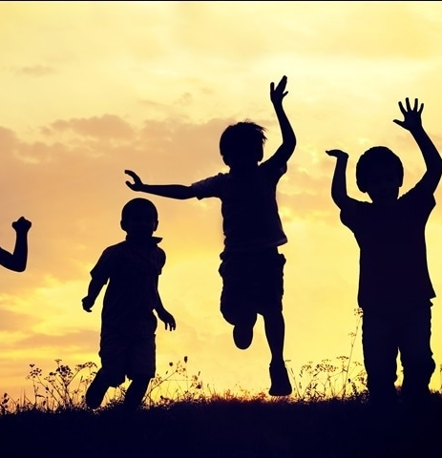
John 6:44
“No one can come to me unless the Father who sent me draws them, and I will raise them up at the last day.
The word “them” includes children.
Praise God!

Slide 5
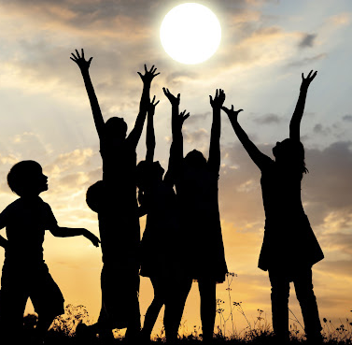
Romans 5:8
But God demonstrates his own love for us in this: While we were still sinners, Christ died for us.
Jesus Christ also died for the children. His grace is for everyone, young and old, men and women

Slide 7
The Church of the Nazarene acknowledges that children are important to God and a priority in His kingdom. We believe God directed us to attend to all children—to love, nurture, protect, uphold, guide, and advocate for them. God has called us, the church, to fulfill His heart and purpose for children.

Slide 8
The Value of Children and Youth
(par 921, COTN Manual 2017-2021)
“The Church of the Nazarene acknowledges that children are important to God and a priority in His kingdom. We believe God directed us to attend to all children—to love, nurture, protect, uphold, guide, and advocate for them…”

Slide 9
The Value of Children and Youth
It is God’s plan that we introduce children to the life of salvation and growth in grace. Salvation, holiness, and discipleship are possible and imperative in the lives of children.

Slide 10
The Value of Children and Youth
We recognize that children are not a means to an end, but full participants in the Body of Christ. Children are disciples in training, not disciples in waiting.

Slide 11
Thus, holistic and transformational ministry to children and their families in every local church will be a priority as evidenced by:

Slide 12
providing effective and empowering ministries to the whole child—physically, mentally, emotionally, socially, and spiritually;
articulating Christian positions on current social justice issues that affect children;
connecting children to the heart of the mission and ministry of the faith community;
discipling children and training them to disciple others;
equipping parents to nurture the spiritual formation of their children

Slide 13
Since the church’s educational institutions (Bible schools, colleges, universities, and seminaries) prepare students for leadership, they play a crucial role in carrying out the vision and mission of communicating the value of children. They join local churches and families in taking responsibility to prepare members of the clergy and laity to raise the next generation of children and youth to be biblically and theologically literate and to meet the known and unforeseen challenges for evangelizing, discipling, and transforming their societies.

Slide 14
OUR VISION
The Church of the Nazarene envisions an intergenerational faith community where children and youth are loved and valued, where they are ministered to and incorporated into the Church family through a wide variety of means and methods, and where they have opportunities to minister to others in ways consistent with their ages, development, abilities, and spiritual gifts.

Slide 15
SMALL GROUP ACTIVITY (15 minutes)
How does God view children? What was God’s original intention and plan for each one of them?
Divide into small groups of not more than 10 members in each group. Get bible.
Explore the bible and find verses that talks about the importance, God’s purpose and vision for children.
Reflect together the verses you found. Allow each member to contribute his/her insights.
Come up with a theme or themes for the verses you explored. For example: God give children as a gift to welcome and nurture (Psalm 127:3).
Assign a reporter from your group to share your group work. Report for not more than 2 minutes.

Slide 16
Share your group work.
Report for not more than 2 minutes.

Slide 17
“Then Jesus said to them, “Whoever welcomes this little child in my name welcomes me; and whoever welcomes me welcomes the one who sent me. For he who is least among you all - he is the greatest.” Luke 9:46

Slide 18
Children everywhere journeying with Jesus…
Discipling the Next Generation

Slide 19
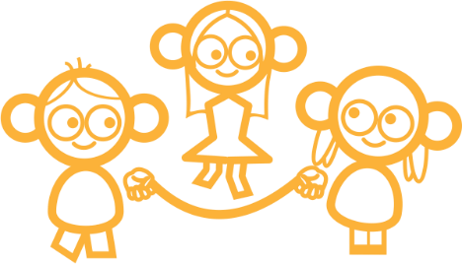
Children
everywhere
journey
with
Jesus
imagine
In your streets,
your communities,
your cities, your nation!
Being salt and light
wherever they go,
shining like stars …
as they hold onto
the Word of Life.

Slide 20
Everywhere you look you see children
the vision
In fact, there are nearly 2 billion children in this world …
In every playground,
apartment block,
sports ground
and shopping mall.
In the villages, the fields, the classrooms.

Slide 21
And in far too many refugee camps, streets, war zones, garbage dumps.
They have been born into a broken world and have been broken by it.
As they grow up in this world, they may feel – safe or afraid. loved or alone, hopeful or despairing.
Sadly, many don't know
Jesus or His love.
BUT ...
the vision

Slide 22
Where ever they are, and whoever they're with – one thing is true.
God values and loves them all!
He wants to heal their brokenness so they can begin to experience wholeness in every dimension of their lives.
the vision

Slide 23
Living in families and communities that are safe and nurturing
Responding to God's love, being discipled and living by His Word
Joining the Body of Christ as active members and discipling other children
Building God's Kingdom and making the world a better place
Becoming the unique people God made them to be
flourishing
God wants children to flourish!

Slide 24
God wants children to flourish!
“All your sons will be taught by the Lord, and great will be your children’s peace.”
“Arise, cry out in the night, as the watches of the night begin; pour out your heart like water in the presence of the Lord. Lift up your hands to Him for the lives of your children, who faint from hunger at the head of every street.”
“See that you do not look down on any on of these little ones. For I tell you that their angels in heaven always see the face of my Father in heaven.”
Isaiah 54:13
Lamentations 2:19
Matthew 18:10-11
flourishing

Slide 25
Flourishing in His Kingdom as they journey in His grace…
Participating
In God’s work and His Kingdom
Integrating
Into the Body of Christ and living life with Jesus
flourishing
As children move from no knowledge of God to becoming active participants.
Discovering
God and a living relationship with Him
Encountering
the Body of Christ in community and action
No Understanding
No knowledge or experience of God and His love

Slide 26
Flourishing in His World…
Children are being transformed as they journey in His grace
As children move from suffering and abuse to becoming positive contributors to society.
flourishing
Suffering
Isolation, deprivation and abuse
Experiencing
Compassion and hope
Gaining
Shelter from threat, stability and nurture
Developing
In personal growth opportunities
Contributing
Positively to society.

Slide 27
Brokenness to Wholeness
Wholeness
Participating
When these two pathways are overlaid each other.
Integrating
flourishing
Suffering
Experiencing
Discovering
Developing
Contributing
Gaining
Encountering
Brokenness
No Understanding

Slide 28
God wants children to flourish!
He longs to see
Children everywhere
walking with Jesus.
Our privilege is to work
with God in this mission.
The question is …
flourishing

Slide 29
How can we work with God to see children everywhere walking with Jesus?
stop think
Stop and think about these big 5s:
5 words
5 steps
5 statements
5 questions

Slide 30
5 words
Children
everywhere
journey
with
Jesus
5 simple words. One compelling and joyful vision.

Slide 31
Children
Seeing them through God’s eyes
Every child is uniquely made in God's image and loved by Him. We need to know and value them as He does if we are to help them walk with Jesus.
How well do I know the children around me, understand their world and allow their voices to be heard and acted upon?
5 steps

Slide 32
everywhere
entering their world
Broken environments lack the safety and nurture that children need. The Good Shepherd longs for children to walk among green pastures and quiet waters where they can thrive.
Are we creating environments of safety and nurture where children can thrive even in the midst of challenging circumstances (i.e. COVID19)?
5 steps

Slide 33
journey
growing in God’s grace
Learning to walk with Jesus starts at an early age and will continue in life… A lifelong discipleship and making Christlike disciples. Learning experiences are vital to developing deep roots in God that will enable children to stand strong in the truth.
5 steps
As I explore life and faith with children, do I demonstrate creativity, relevance and a confidence that God speaks to them through the Bible and prayer and life experiences?

Slide 34
with
thriving through relationships
God seeks a relationship with every child. As we walk along with them, we support them and help them to make sense of life and faith.
Do I see my relationships with children as opening possibilities for them to have life-changing experiences with God?
5 steps

Slide 35
Jesus
bringing Jesus to others
As children walk with Jesus, they bring Him and His message of hope into their world. They can share Him in places and ways that adults can’t. Children make Christlike disciples.
Am I overlooking the contribution children can make to the Great Commission?
5 steps

Slide 36
Children everywhere journey with Jesus

Slide 37
How can we work with God to see children everywhere walking with Jesus?
Share significant learning and insights gained from your understanding of the Journey of Grace and its relationship to Discipling of Children?
List down some possible action steps to take after this workshop.
Summarize group learning and ideas for action and present them.
Small group discussion
(15 minutes)
What is our Part in Fulfilling God's Heart for Children?

Slide 38
“Speak up for those who cannot speak for themselves, for the rights of all who are destitute. Speak up and judge fairly: defend the rights of the poor and needy”
(Proverbs 31:8)
Small group discussion

Slide 39
Current Activities:
What Am I Doing Now in Discipling Children?
Format for action steps
Practical Actions to Consider:
What I will continue doing.
What I will start doing.

Slide 40
Share your group work.
Report for not more than 2 minutes.

Slide 41
Current Activities:
What Am I Doing Now in Discipling Children?
Format for action steps
Practical Actions to Consider:
What I will continue doing.
What I will start doing.

Slide 42
We achieve the goal of children everywhere
journey with Jesus through ...
seminaries
journey
children
organizations
families
churches

Slide 43
families that …
journey
1. Celebrate the unique gifts and journeys of each child.
2. Ensure that the family is a safe place for children to grow and learn.
3. Model and pass on faith in everyday circumstances.
4. Serve God together in church and community.

Slide 44
1. Welcome children and families into a safe and nurturing community which serves their holistic needs.
2. Support and equip families to be centers of faith development.
3. Pray, learn, serve and celebrate together across the generations.
4. Create opportunities for children to explore their God-given gifts and walk alongside them as they learn.
journey
churches that …

Slide 45
children that …
1. Know that their gifts are valued and have opportunities to use them.
2. Share their faith with others in creative ways.
3. Are active participants in building God's Kingdom.
journey

Slide 46
1. Meet children's practical needs for food and shelter, health and education.
2. Advocate for children's rights at all levels of community and government.
3. Explore innovative approaches that address the changing, often difficult, realities for today's children and families and ensure that these are adequately resourced.
4. Encourage children to contribute to the well-being of the community.
partnerships
among
Christian
and secular
organizations
that ...
journey

Slide 47
1. Impact all church leaders by including a robust theology of ministry to children and families in every academic discipline.
2. Ensure that children's ministry is a genuine, academic option.
3. Become regional centers for networking, conversation and resources in ministry to children and families.
theological
institutions
and seminaries
that ...
journey

Slide 49
Journey of Grace Initiative of
Church of the Nazarene-GMA
children everywhere journey with Jesus
Getting started on the journey together…
Children Everywhere Journey with Jesus is to challenge and equip the church to rethink her ministry to and with children and family so that the church can better help children to follow Jesus and keep walking in his grace and live a lifestyle of holiness.

Slide 50
One on one discipling, training, equipping and mentoring of emerging leaders (children and teens).
Alongsider
children everywhere journey with Jesus

Slide 51
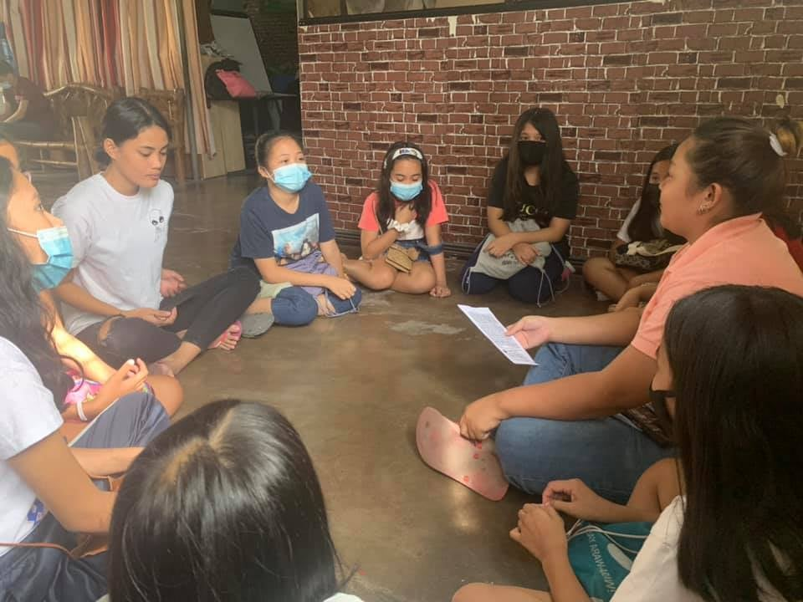
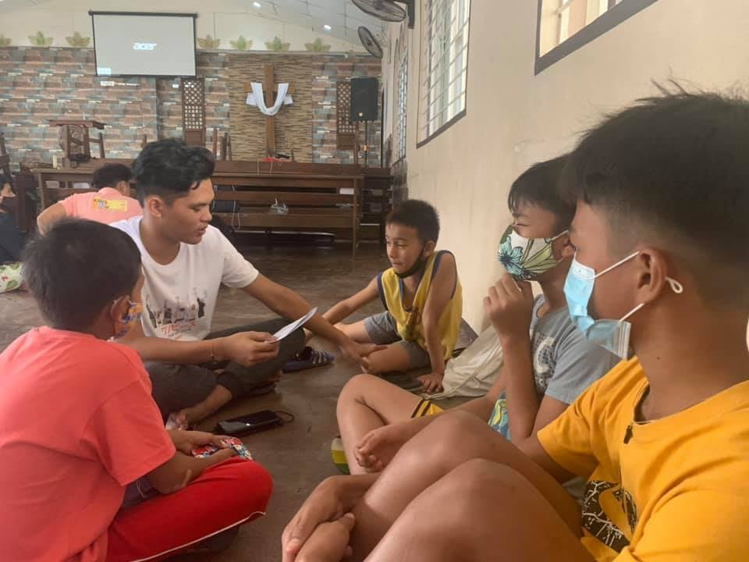
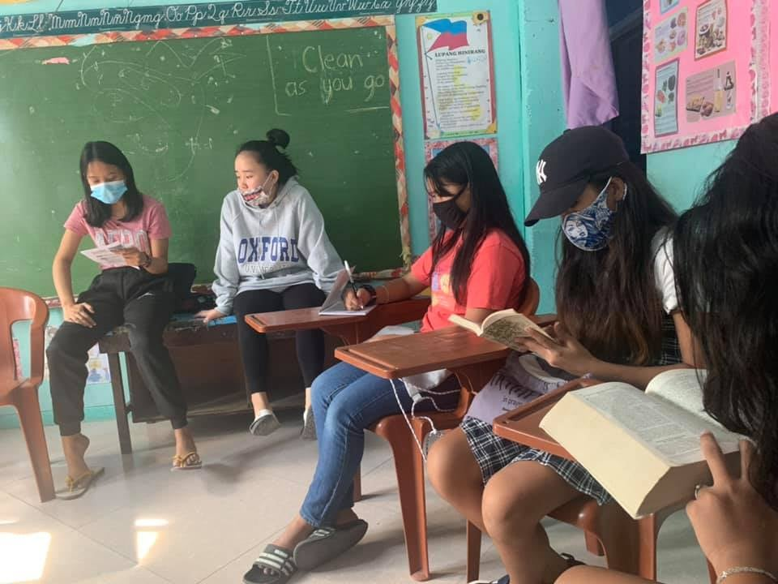
Children and Teens are trained and equipped to organize and lead small groups of children and teens for discipleship class.
KID’S BLAST:
Kids Discipling Kids
children everywhere journey with Jesus

Slide 52
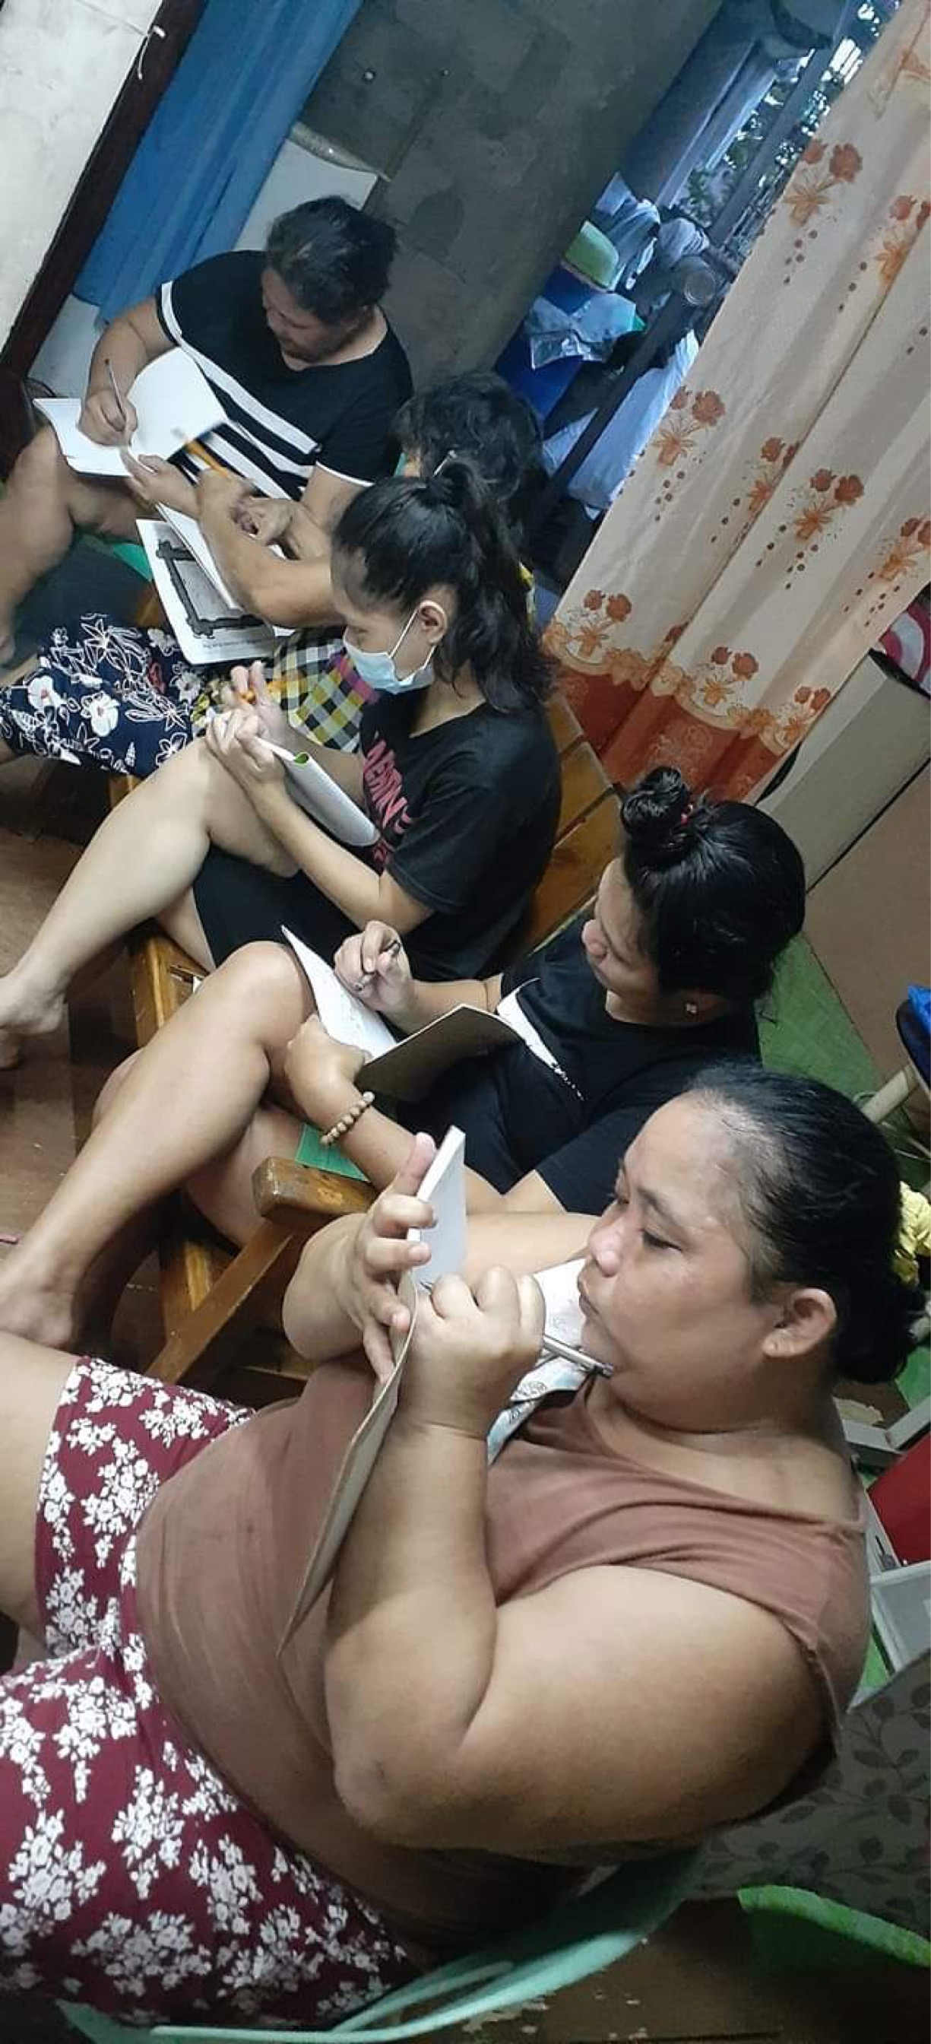
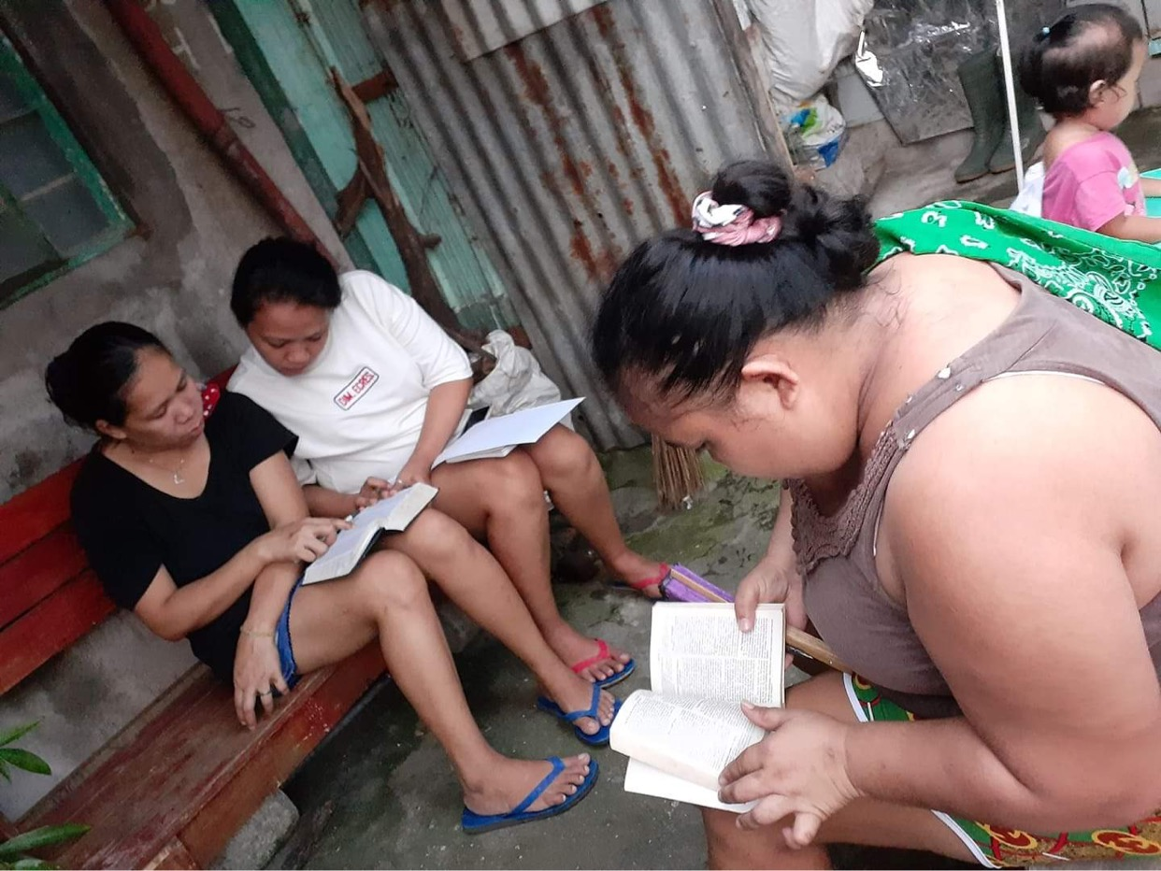
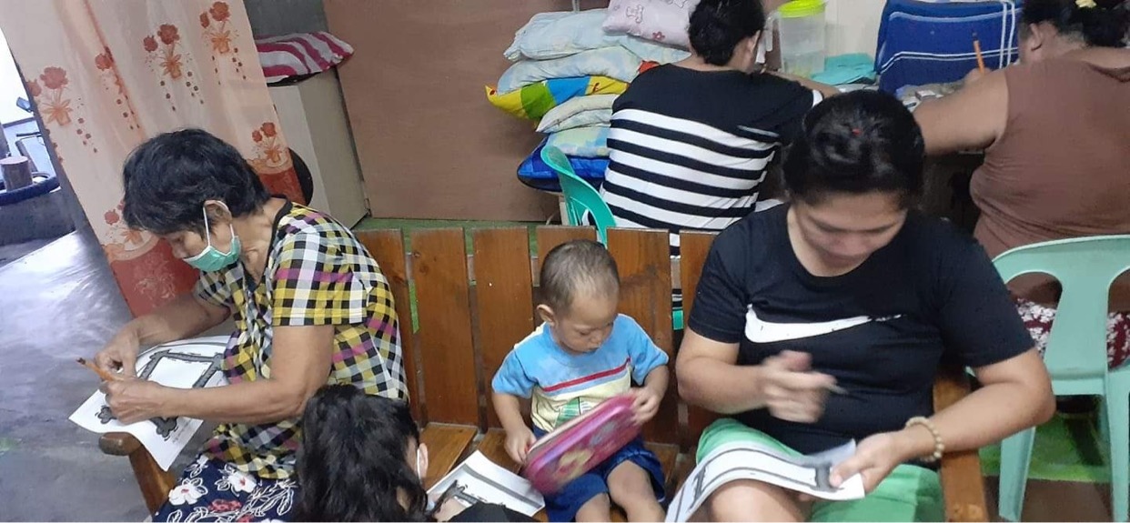
Discipleship class of parents and families. Training and Equipping parents to be transformational parents and disciplers of their children.
TRANSFORMATIONAL LIFE GROUP (TLG)
children everywhere journey with Jesus

Slide 53
Children everywhere walking with Jesus…
Discipling the Next Generation

