Slide 1
Social Inclusion of People with Motor Disabilities.

Slide 2
DEFINICIONES
DEFICIENCY
All loss or abnormality, permanent or temporary, of a structure or function, psychological, physiological or anatomical.
DISABILITY
Any restriction or absence, due to an impairment, of the ability to perform an activity in the manner or within the range considered normal for a human being.
MINUSVALIA
It is the disadvantageous situation in which a given person finds himself/herself, as a consequence of an impairment or disability.

Slide 3
DEFINICIONES
HEALTH CONDITION
PERSONAL FACTORS
ENVIRONMENTAL INFLUENCES
DISABILITY

Slide 4
PHYSICAL DISABILITY
It is that situation or state of motor deficiency, in which there is a circumstance that prevents or hinders to a great extent, the freedom and full functionality in the execution of their movements. They are due to one or several anomalies in the functioning of the bone-articular, muscular or nervous system. They can be transitory or permanent.

Slide 5
CLASSIFICATION
Muscular Origin
Cerebral origin
Spinal Origin
Bone-articular origin

Slide 6
CLASSIFICATION
Motor
Alterations that cause difficulties to totally or partially perform movements, due to a malfunction of the bone, joint and/or muscular system.
Neuromotor
Alterations caused by damage to the central nervous system before it completes its development.

Slide 7
CLASSIFICATION BY LOCATION TOPOGRAPHIC
MONOPLEJIA
Affects a single limb, arm or leg
PARAPLEJIA
Affects lower limbs
HEMIPELJIA
Single side of the body, Hemibody
DIPLEJIA
Affects four extremities with predominance in the lower extremities.
TRIPLEJIA
Affection of lower extremities and one upper extremity
QUADRIPLEJIA
Affected all four members
TETRAPLEJIA
Global involvement including trunk and extremities with predominance in upper limbs.

Slide 8
When It May Occur
ETAPAS:
PRENATAL
Ingestion of drugs or toxins.
Maternal malnutrition
Threats of miscarriage
Maternal trauma
PERINATAL
Low birth weight
Prolonged labor
Difficult delivery
Asphyxia or anoxia due to cervical circular motion
Prematurity
POSTNATAL
Trauma,
High fevers, infections
infections,
anoxia,
asphyxia,
cerebral palsy,
vascular accidents and others

Slide 9
UNIVERSAL ACCESSIBILITY
The condition that environments, processes, goods, products and services, as well as objects or instruments, tools and devices, must meet in order to be understandable, usable and practicable by all people in conditions of safety and comfort and in the most autonomous and natural way possible.

Slide 10
DESIGN FOR ALL
It is a strategy that aims to design products and services that can be used by the largest possible number of people, considering that there is a wide variety of human abilities and not an average ability, without the need to carry out an adaptation or specialized design, simplifying the lives of all people, regardless of their age, size or ability.

Slide 11
Reasonable Adjustments
Necessary and appropriate modifications and accommodations that do not impose a disproportionate or undue burden, where needed in a particular case, to ensure to persons with disabilities the enjoyment or exercise on an equal basis with others of all human rights and fundamental freedoms shall mean the following

Slide 12
Barriers to Inclusion of Persons with Physical Disabilities
Physical/Environmental Barriers
Attitudinal Barriers
Communication Barriers
Policy Barriers

Slide 13
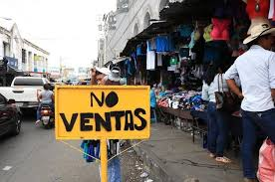
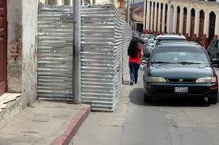
Physical / Environmental Barriers
Urban Architectural Barriers

Slide 14
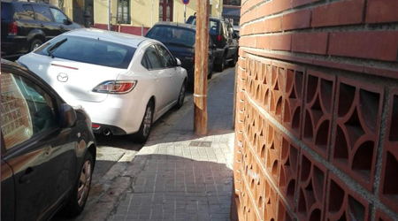
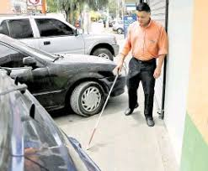
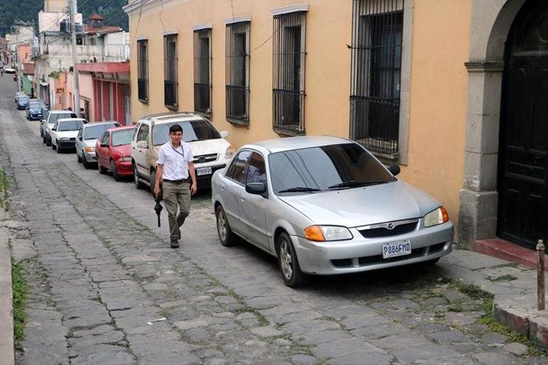

Slide 15
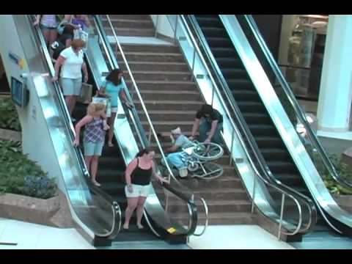
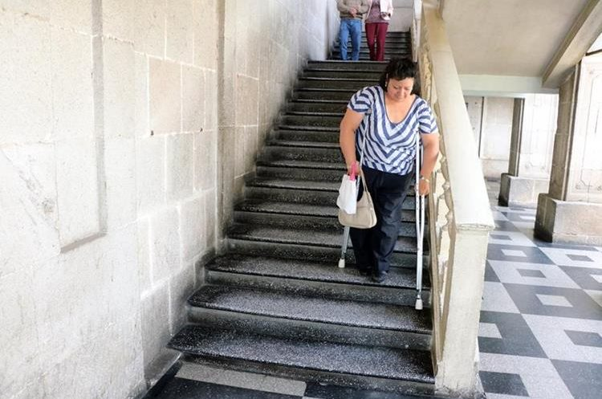
Physical / Environmental Barriers
2. Architectural Barriers in Buildings

Slide 16
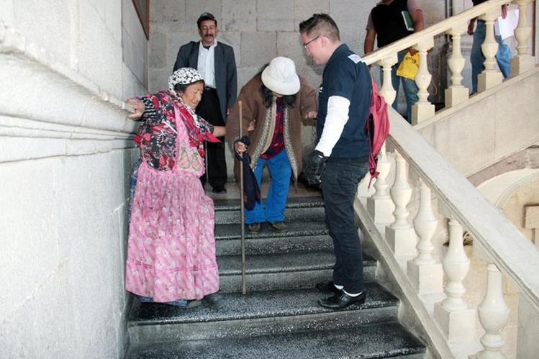
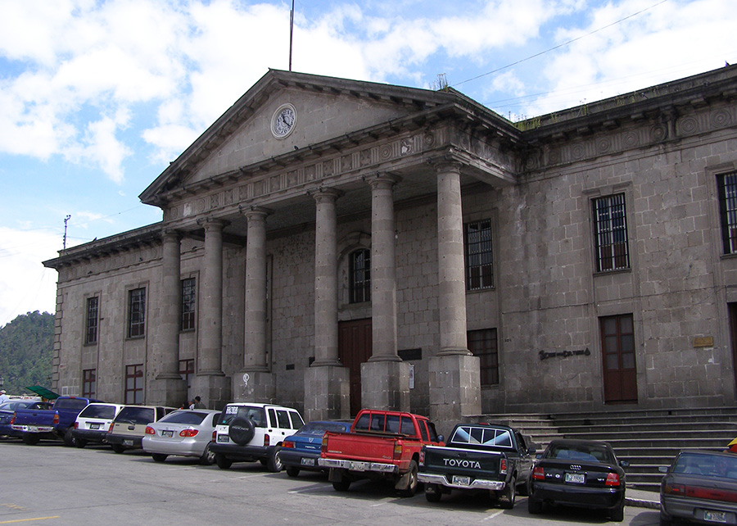

Slide 17
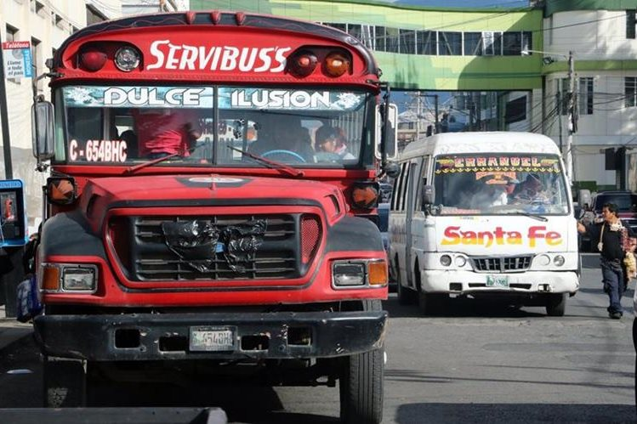
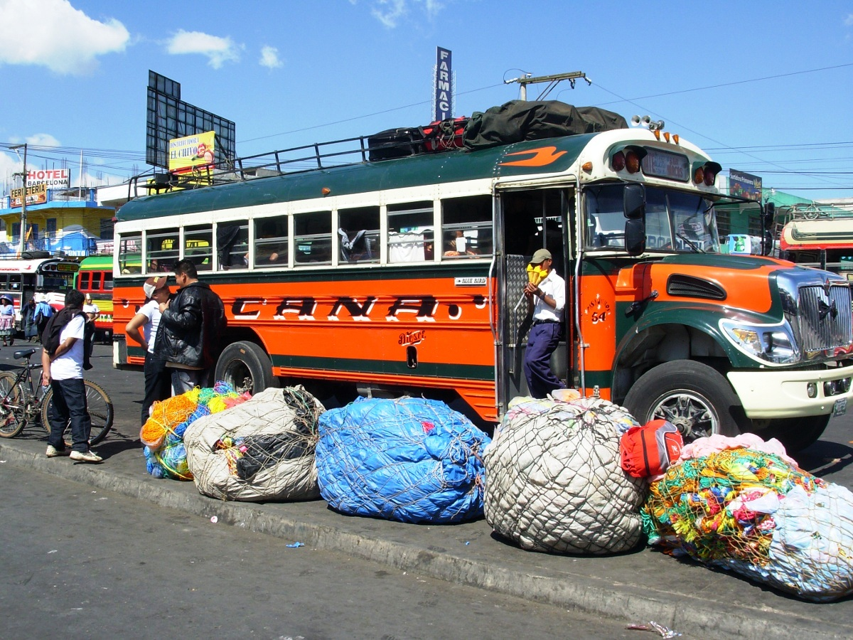
Physical / Environmental Barriers
3. Architectural barriers in transportation

Slide 18
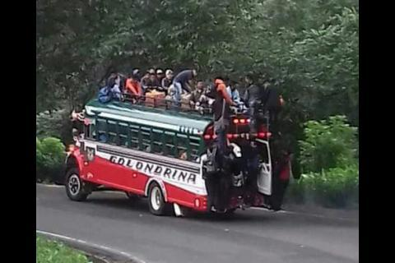
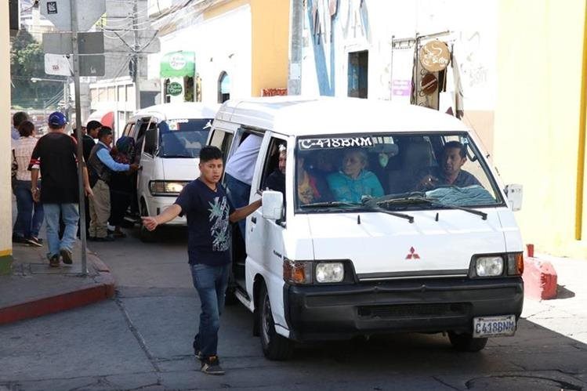
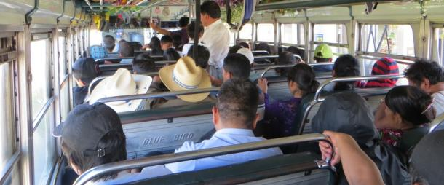

Slide 19
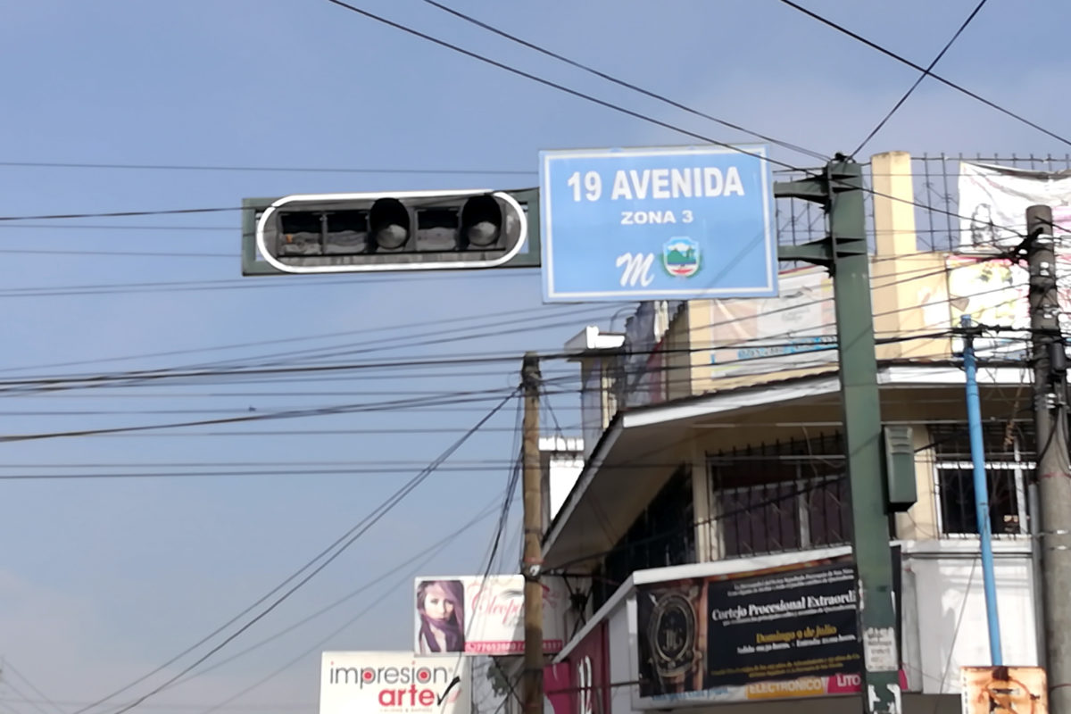
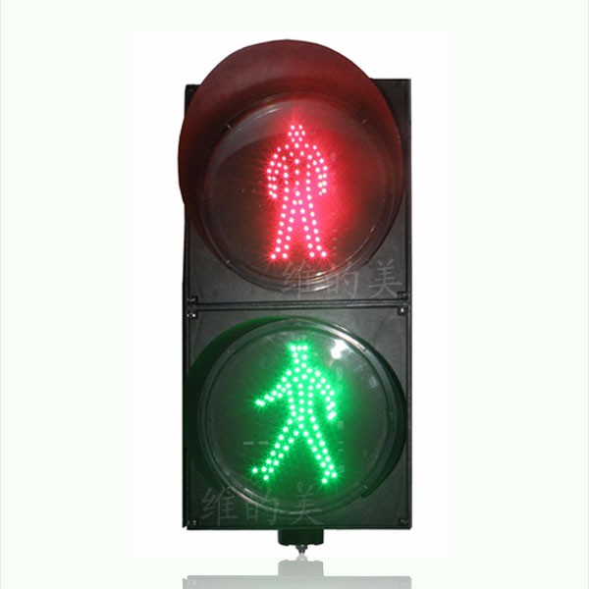
Physical / Environmental Barriers
4. Architectural barriers to communication

Slide 20
Lic. Wener Manolo Dionicio Fuentes
Physical and Occupational Therapist

