Slide 1
Time to...
Finished
Greetings
We pray
We sing

Slide 2
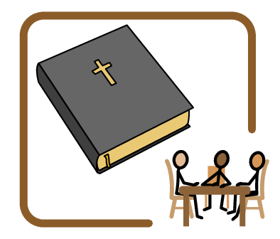
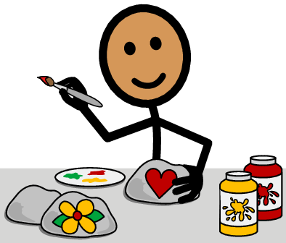
Time to...
Finished
Read/study the Bible
Paint (Color)
Making a craft

Slide 3
Time to...
Finished
Offering
Saying goodbye

