Slide 1
Workshop for parents of children with disabilities

Slide 2
Getting started with your child's disability

Slide 3
Where to start?
Welcome to Holland A
reflection by Emily
Perl Kingsley, 1987.
The impact of the diagnosis:
Personal History
Personal Traits
Values Scale
Support Network

Slide 4
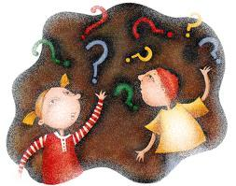
Grief Process
Stage I.
Spectator
When we receive the news that our child or family member has a disability, parents are often unable to understand the situation we are going through.

Slide 5
Grief Process
Stage II. Fear
This situation of panic is normal, it happens almost every time and parents who suffer from it should be aware of it, it is a temporary but complicated feeling to handle.

Slide 6
Grief Process
Stage III. Feeling of Guilt
It is common for parents of the child with a disability to make an analysis of their own actions looking for ways to blame themselves for the situation:
I should have been more insistent that I use caution on the road.
it is my body that is responsible for my child's situation.
I should have gone to another clinic to give birth.

Slide 7
Grief Process
Stage IV. Denial
We refuse to end our first mourning situation, we do not want to assume reality even though we have understood it.

Slide 8
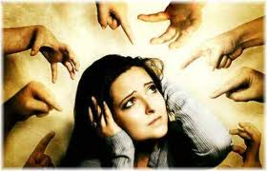
Reasons that hinder
the grieving process:
Not knowing what is normal and repressing feelings we don't like.
Fear of facing pain alone.
Feelings of guilt.
Chronic frustration and anger.
Staying in sadness and grief.
Blaming ourselves.
Isolating ourselves from our feelings.

Slide 9
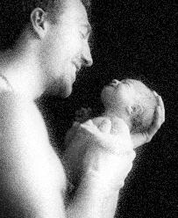
Grief Process
Stage V. Affirmation of reality
Gradually in most cases the situation is assumed and the reality is understood with greater logic, reaching this situation depends on many factors.

Slide 10
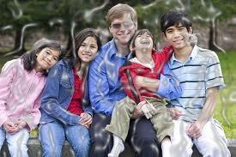
Lean on the Family
The family has the basic objective of organizing itself to meet all the needs and demands of the member with a disability in order to promote the development, well-being and stability of all.

Slide 11
Does any of this resemble what I have experienced?

Slide 12
Final Reflections
To make the adaptation period as short as possible
Favor the contact and expression of emotions.
to improve the quality of the emotional environment, increasing the level of expectations.
to reflect on the real situation.
to enhance the family's capabilities for the care of the child.

Slide 13
Recommendations for the families:
Remember the 5 P's:
Probe,
Petition,
Procure,
Protest, and
Persevere.

