Slide 1
1

Slide 2
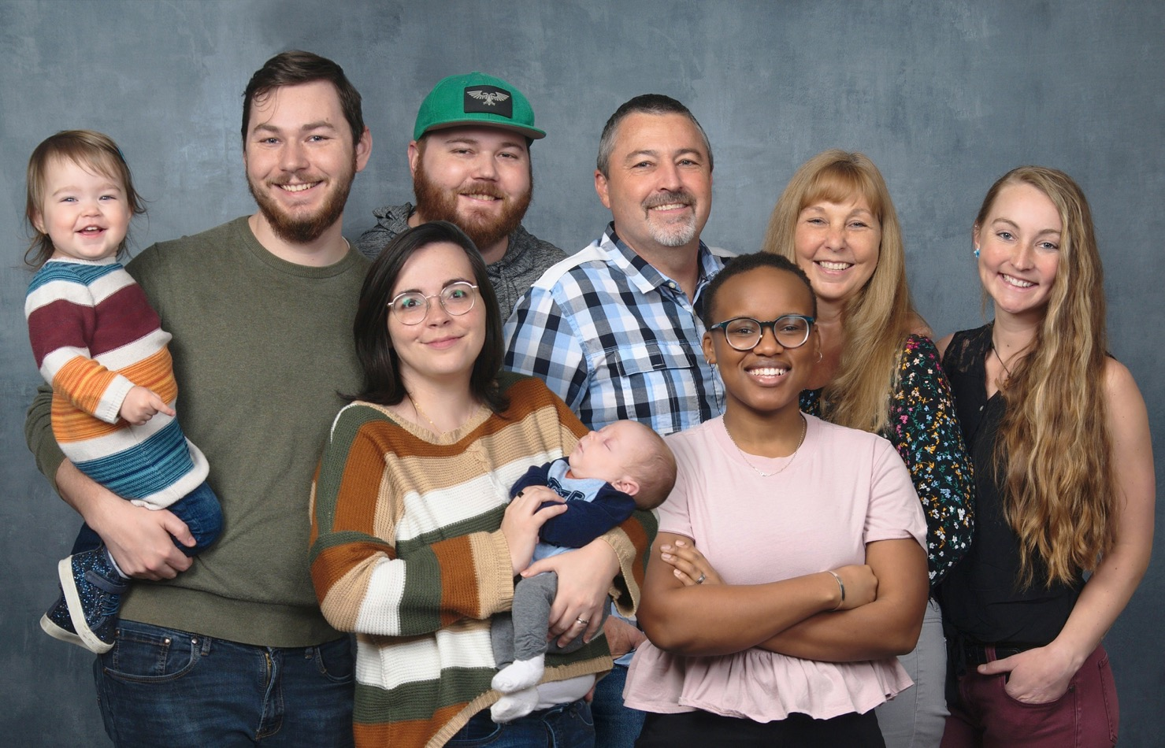

Slide 3


Slide 4

SIGHTS & SOUNDS
OF THE
MESOAMERICA
REGION

Slide 5
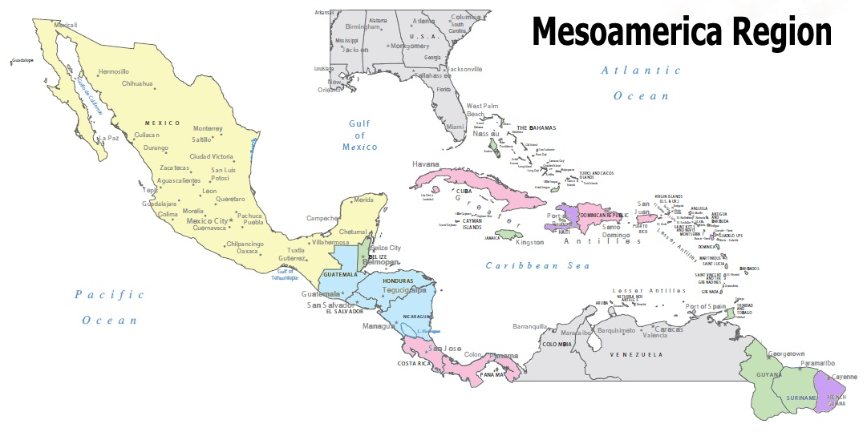
HAITI FIELD
FLORIDA
MEXICO
HAITI
SOUTH AMERICA

Slide 6
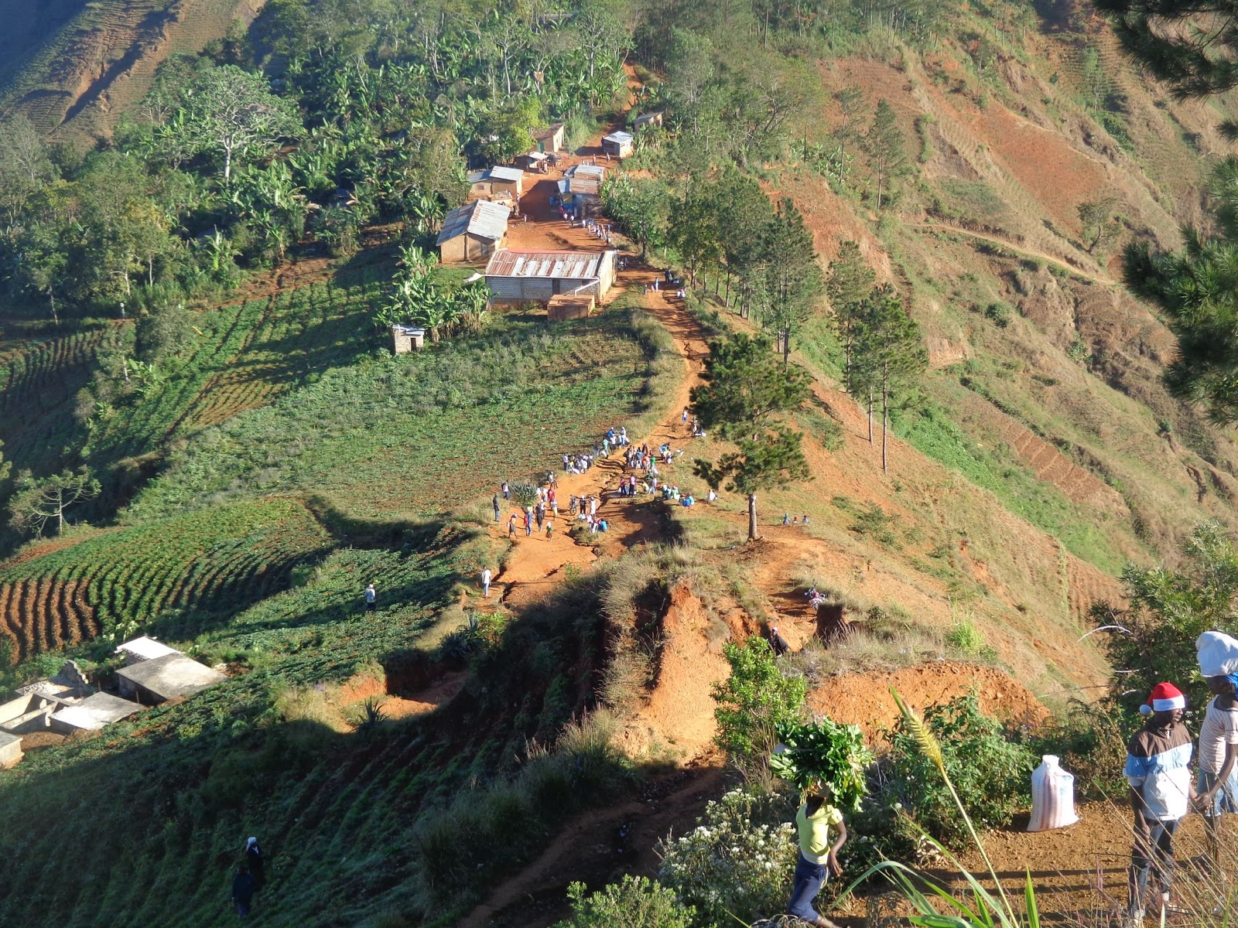

Slide 7
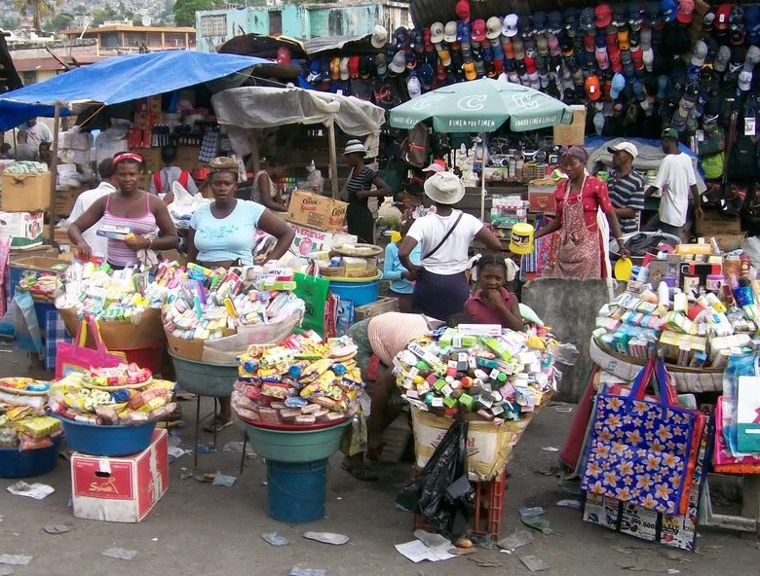
Haiti

Slide 8
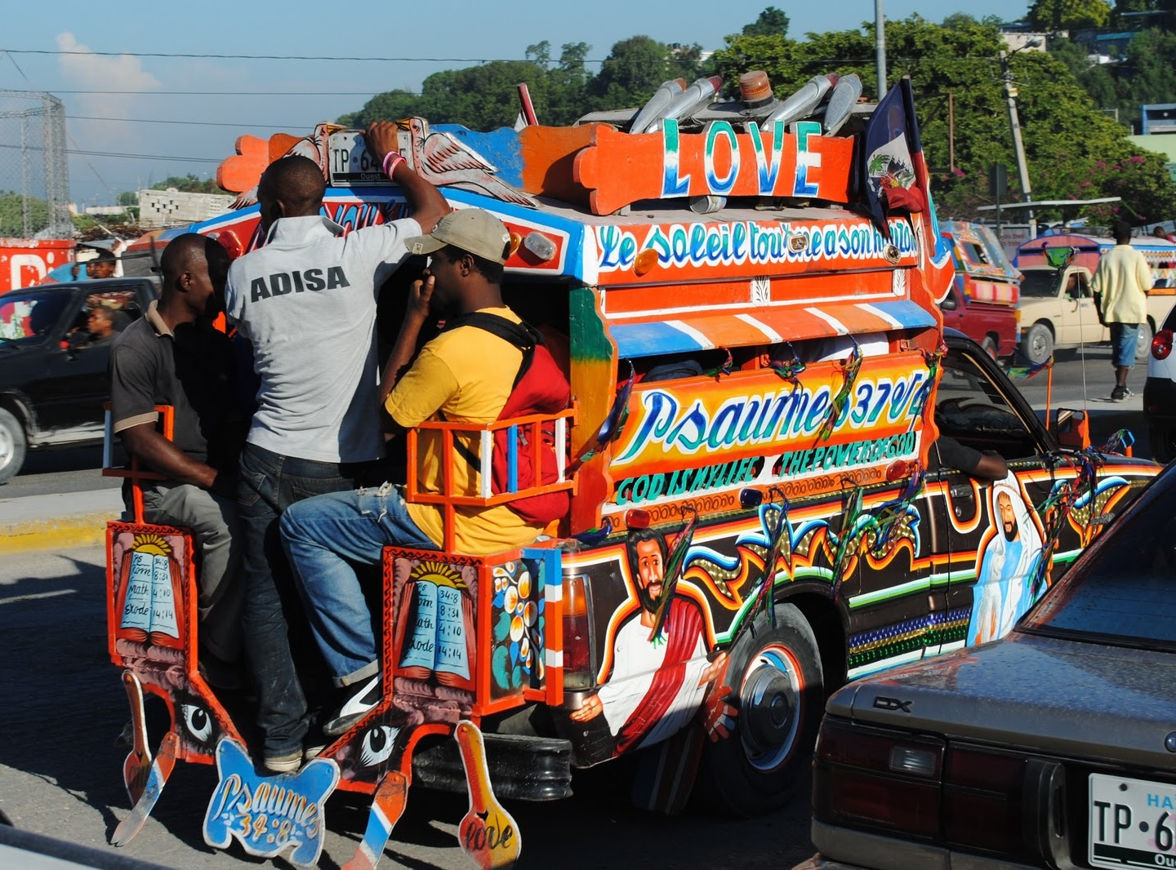

Slide 9
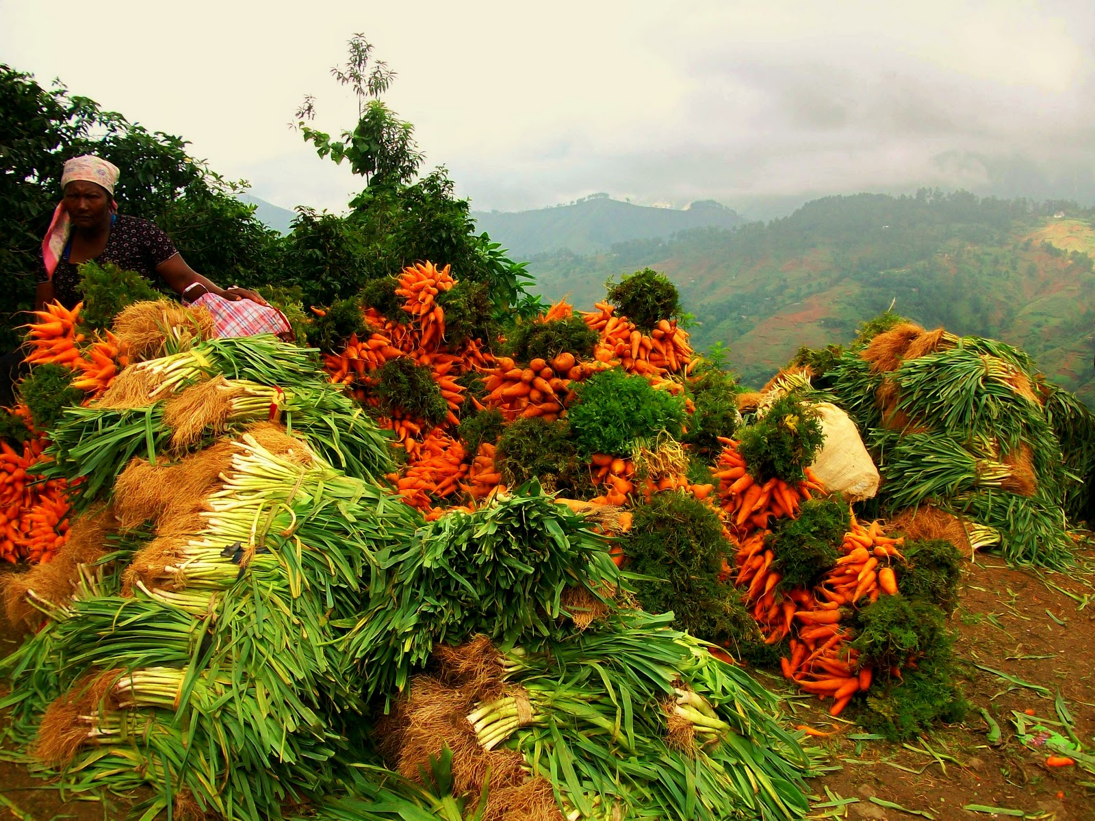

Slide 10
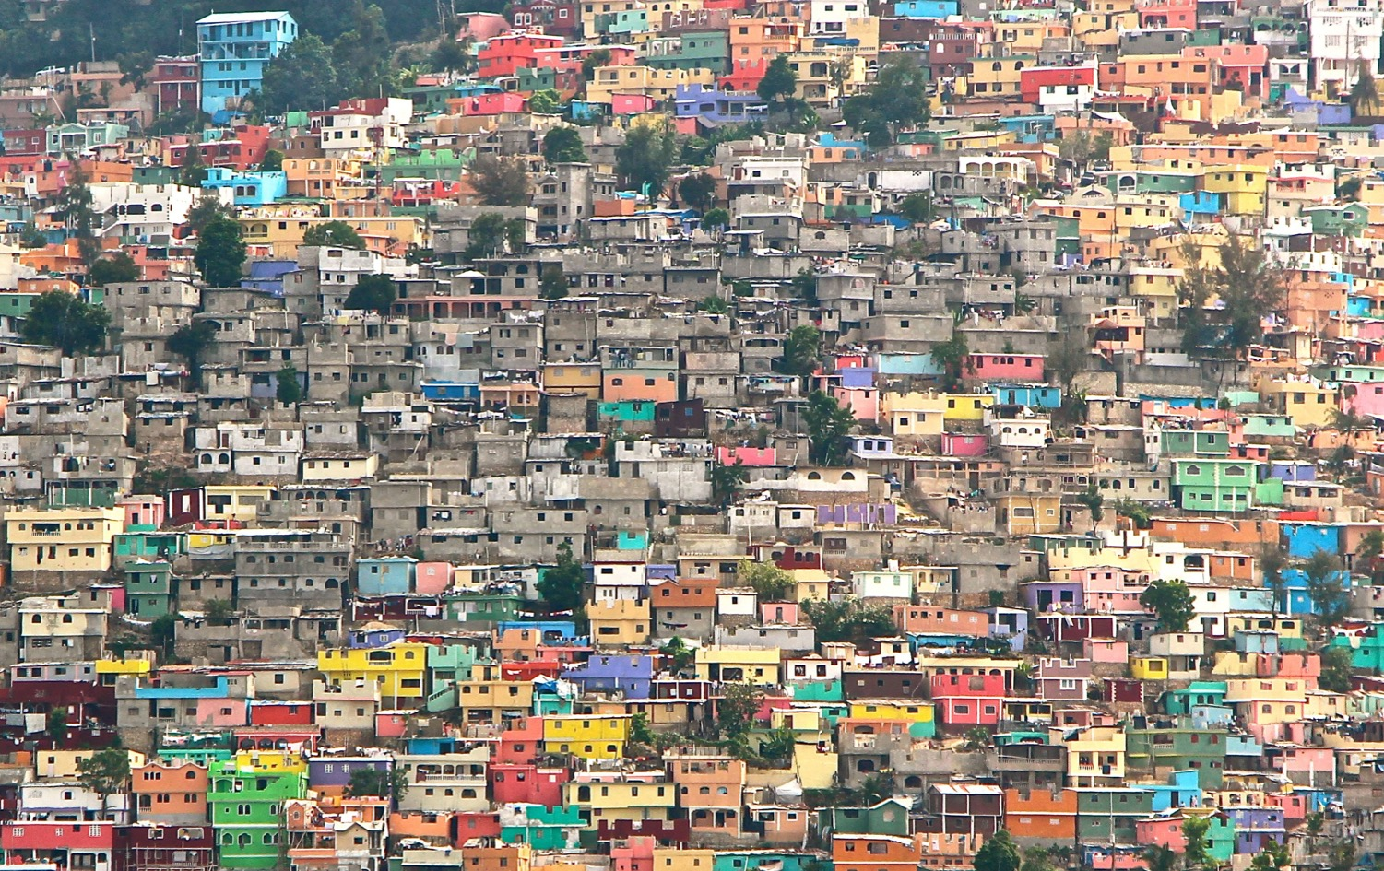

Slide 11
Caribbean Field – Part1
THE BAHAMAS
FLORIDA
MEXICO
ANTIGUA & BARBUDA
BELIZE
DOMINICA
BARBADOS
ARUBA
GRENADA
SOUTH AMERICA
SURINAME

Slide 12
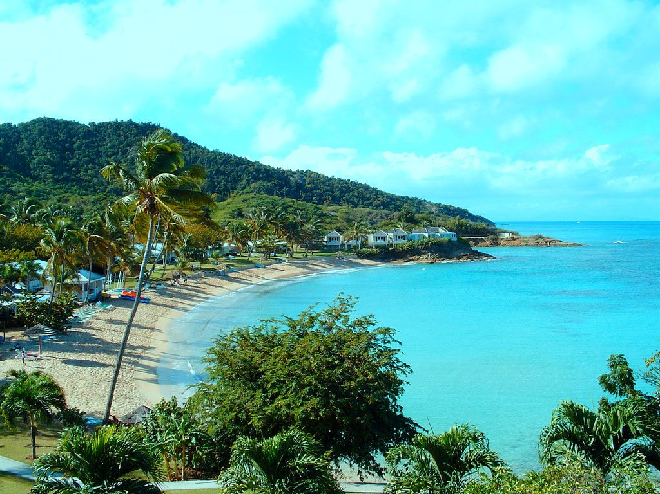
Antigua

Slide 13
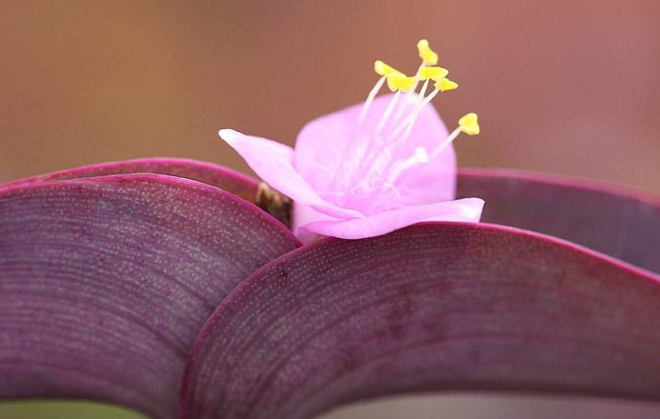

Slide 14
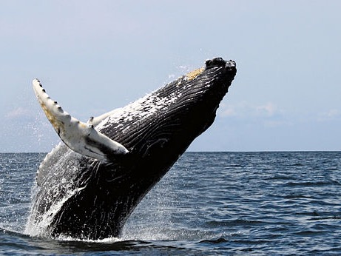

Slide 15
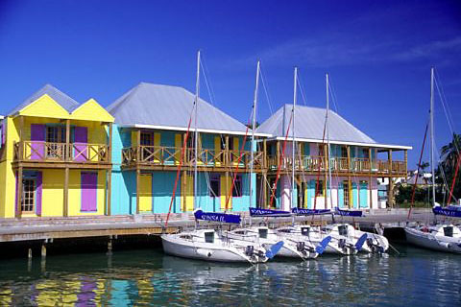

Slide 16
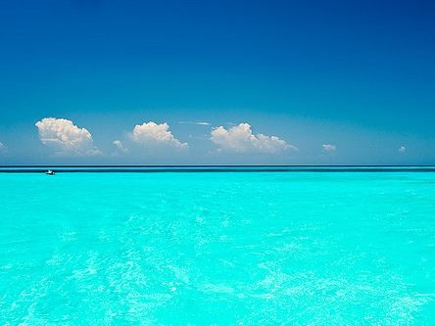
Bahamas

Slide 17
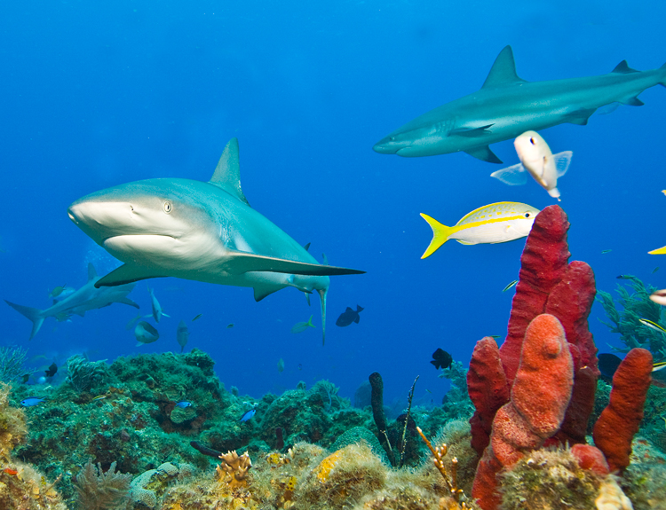

Slide 18
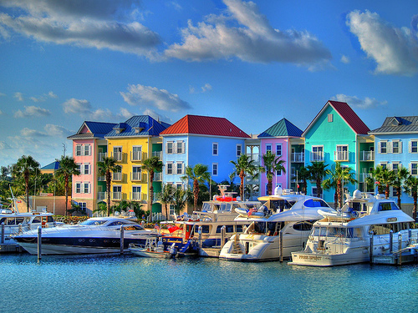

Slide 19
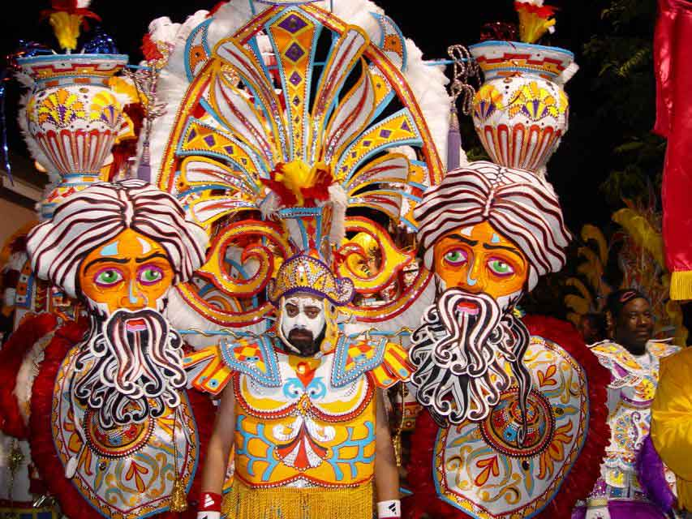

Slide 20
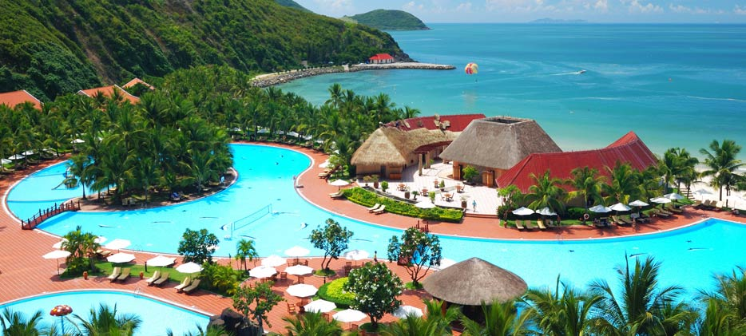
Barbados

Slide 21
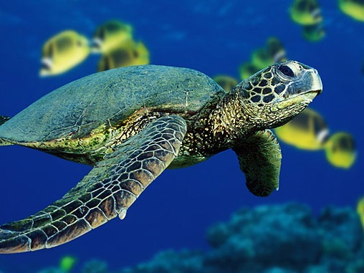

Slide 22


Slide 23
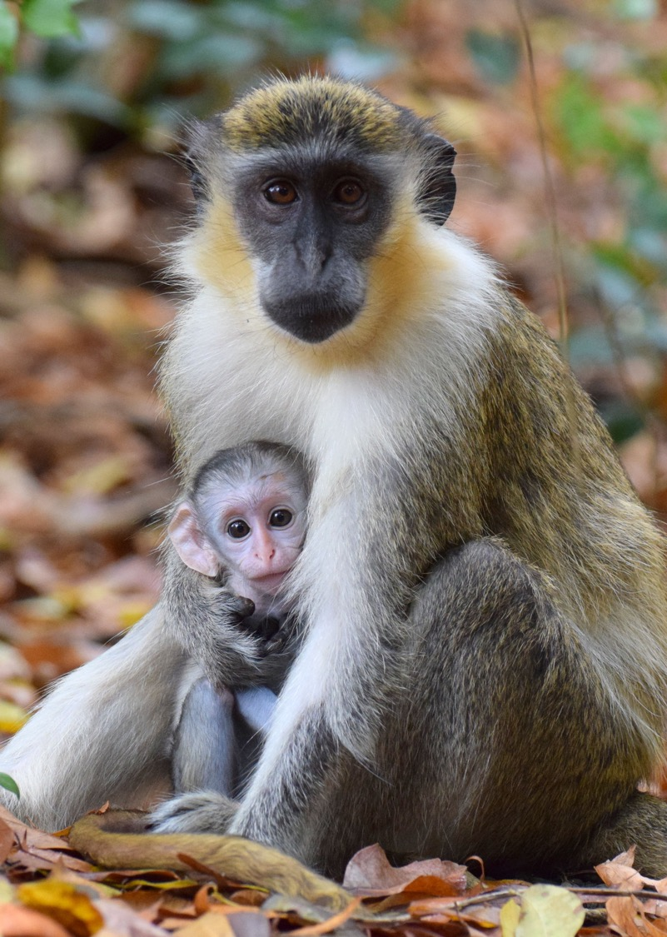

Slide 24
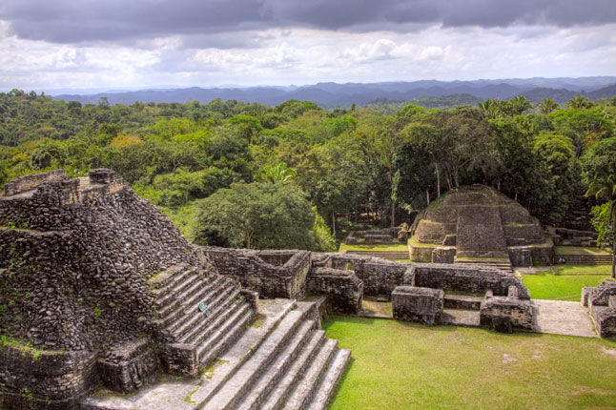
Belize

Slide 25
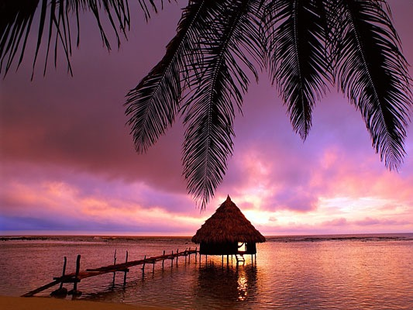

Slide 26
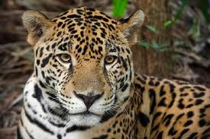

Slide 27
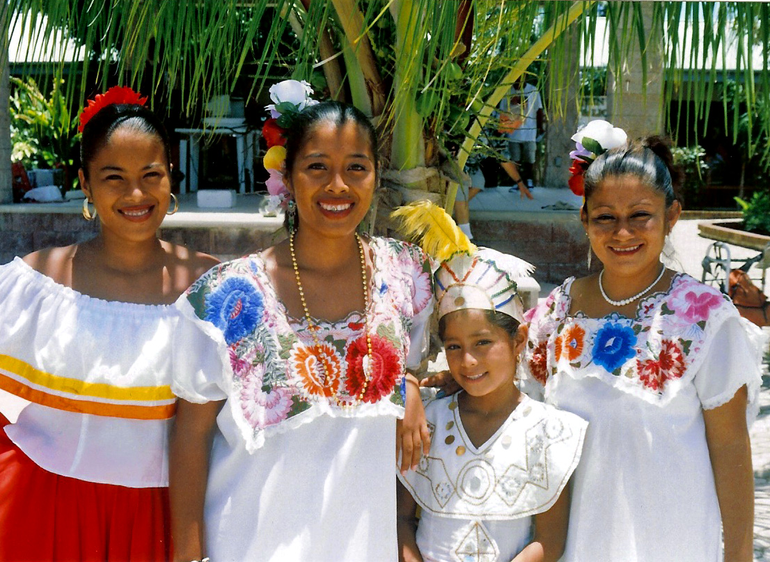

Slide 28
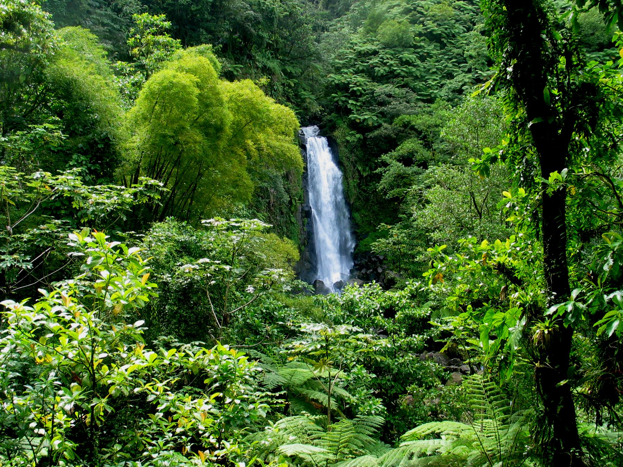
Dominica

Slide 29
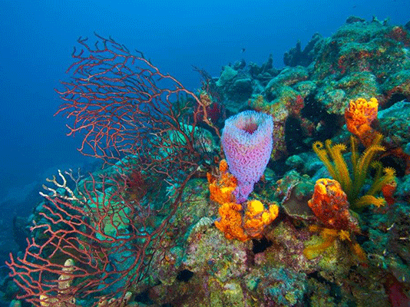

Slide 30
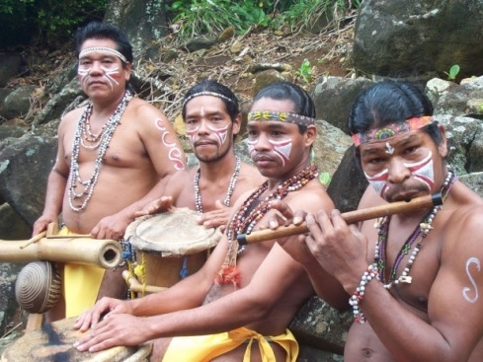

Slide 31


Slide 32
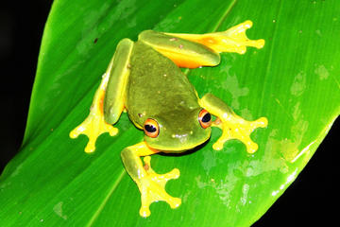

Slide 33
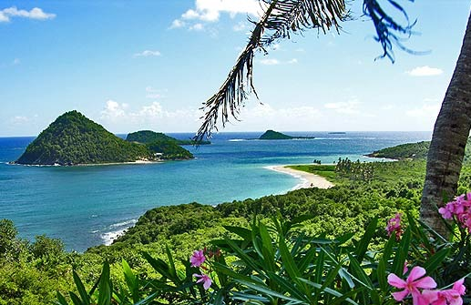
Grenada

Slide 34
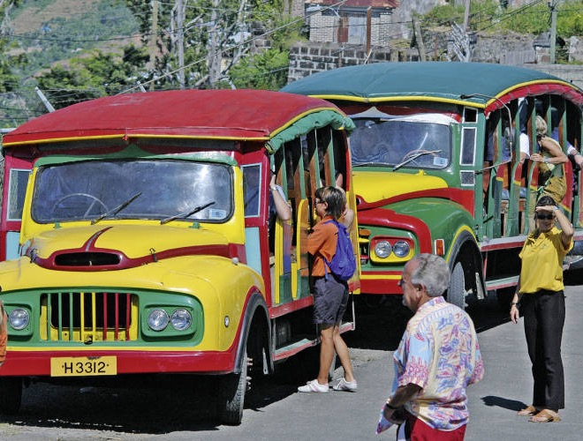

Slide 35
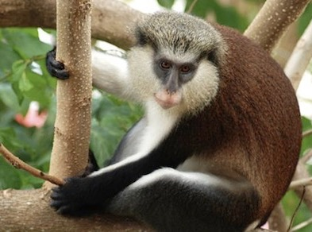

Slide 36
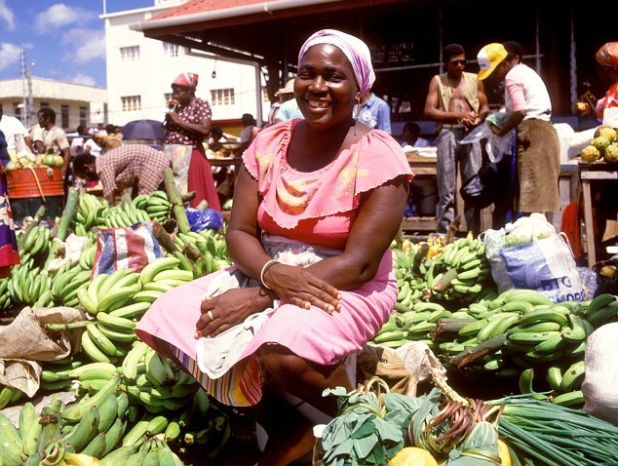

Slide 37
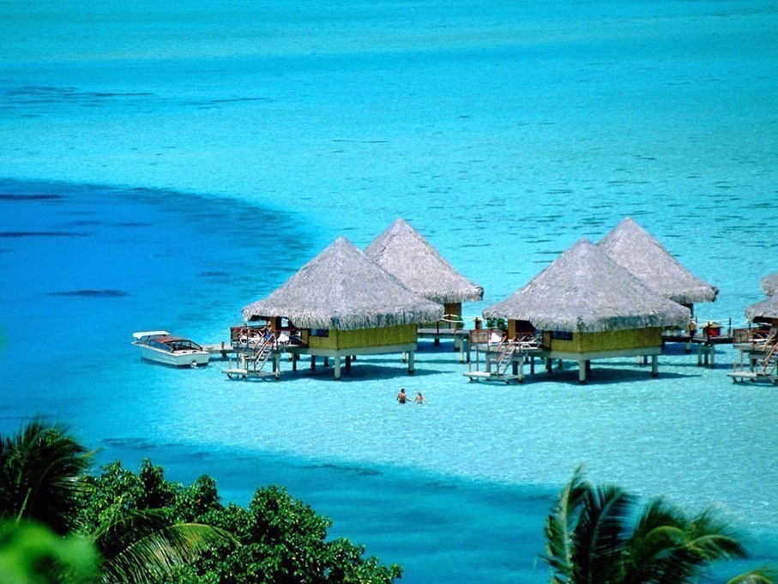
Aruba

Slide 38


Slide 39


Slide 40
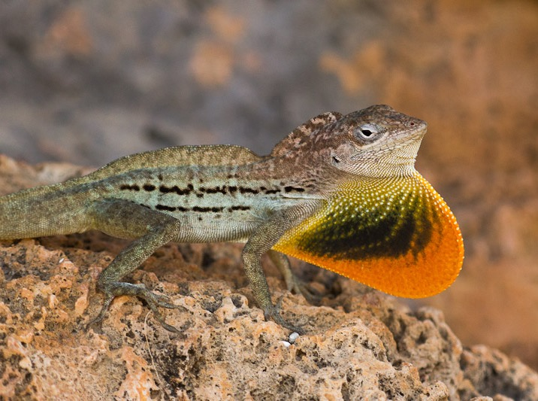

Slide 41
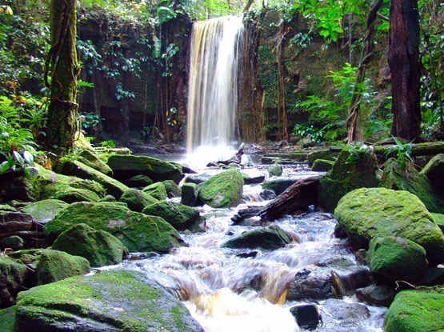
Suriname

Slide 42
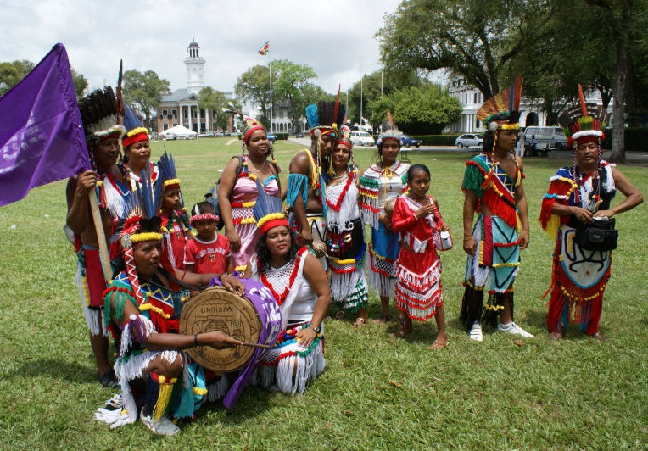

Slide 43
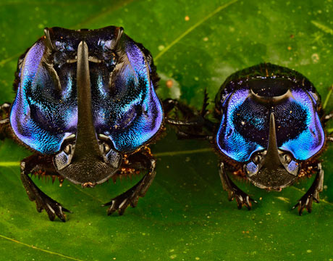

Slide 44
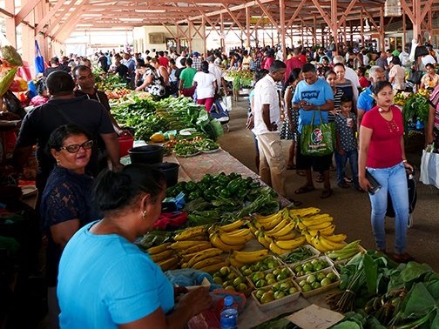

Slide 45
Caribbean Field – Part 2
U.S Virgin Islands: St. Croix, St. Kitts & Nevis, St. Lucia, St. Vincent & the Grenadines
FLORIDA
MEXICO
Jamaica
Winward Islands
Trinidad & Tobago
SOUTH AMERICA

Slide 46
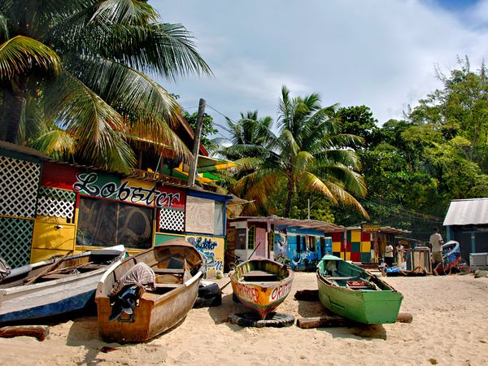
Jamaica

Slide 47
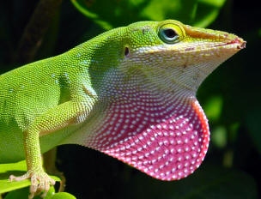

Slide 48
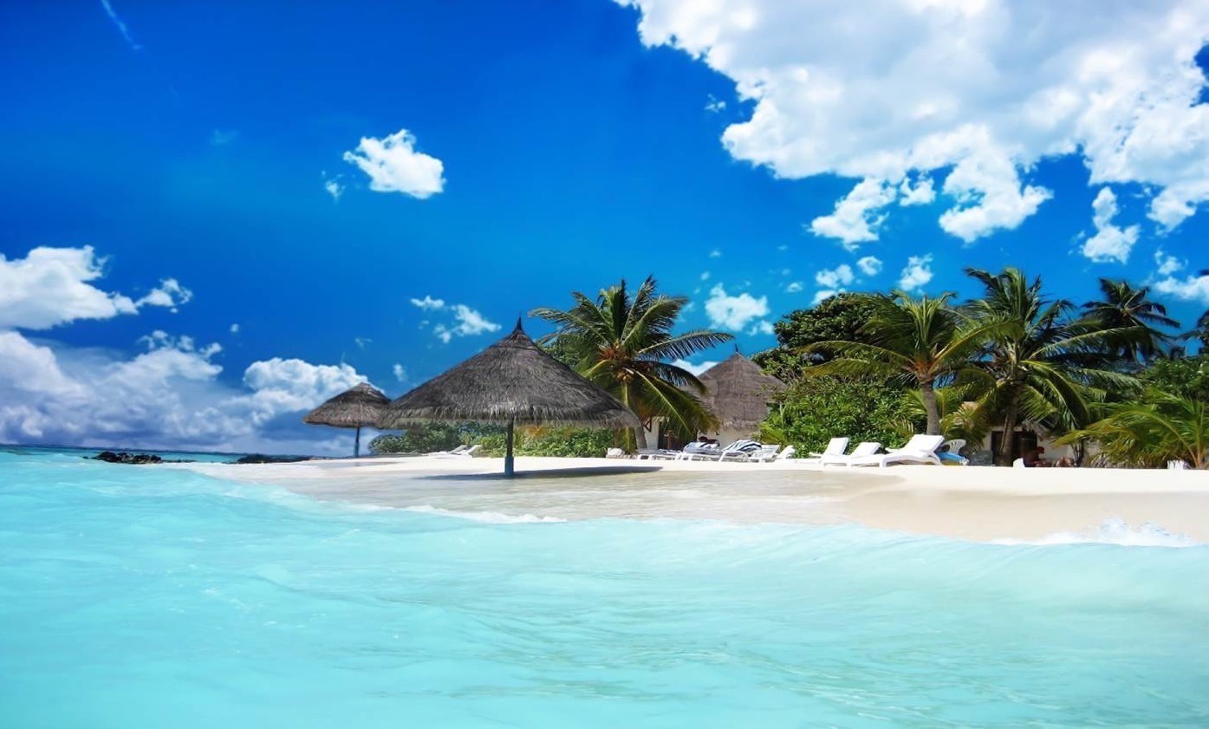

Slide 49


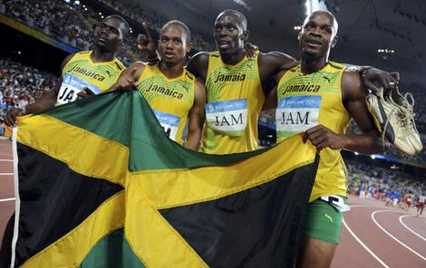

Slide 50
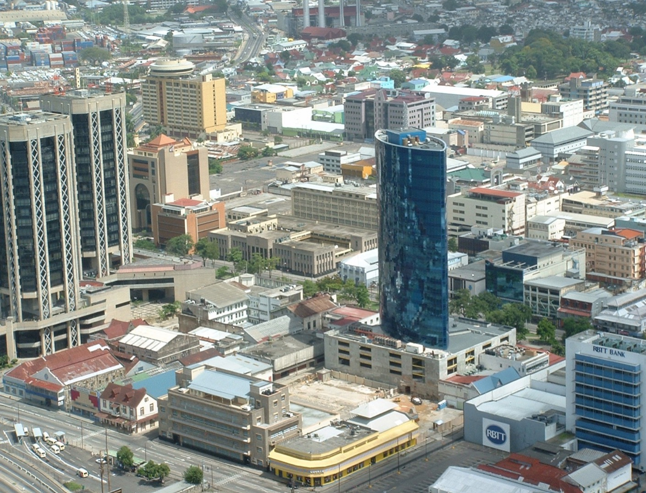
Trinidad

Slide 51
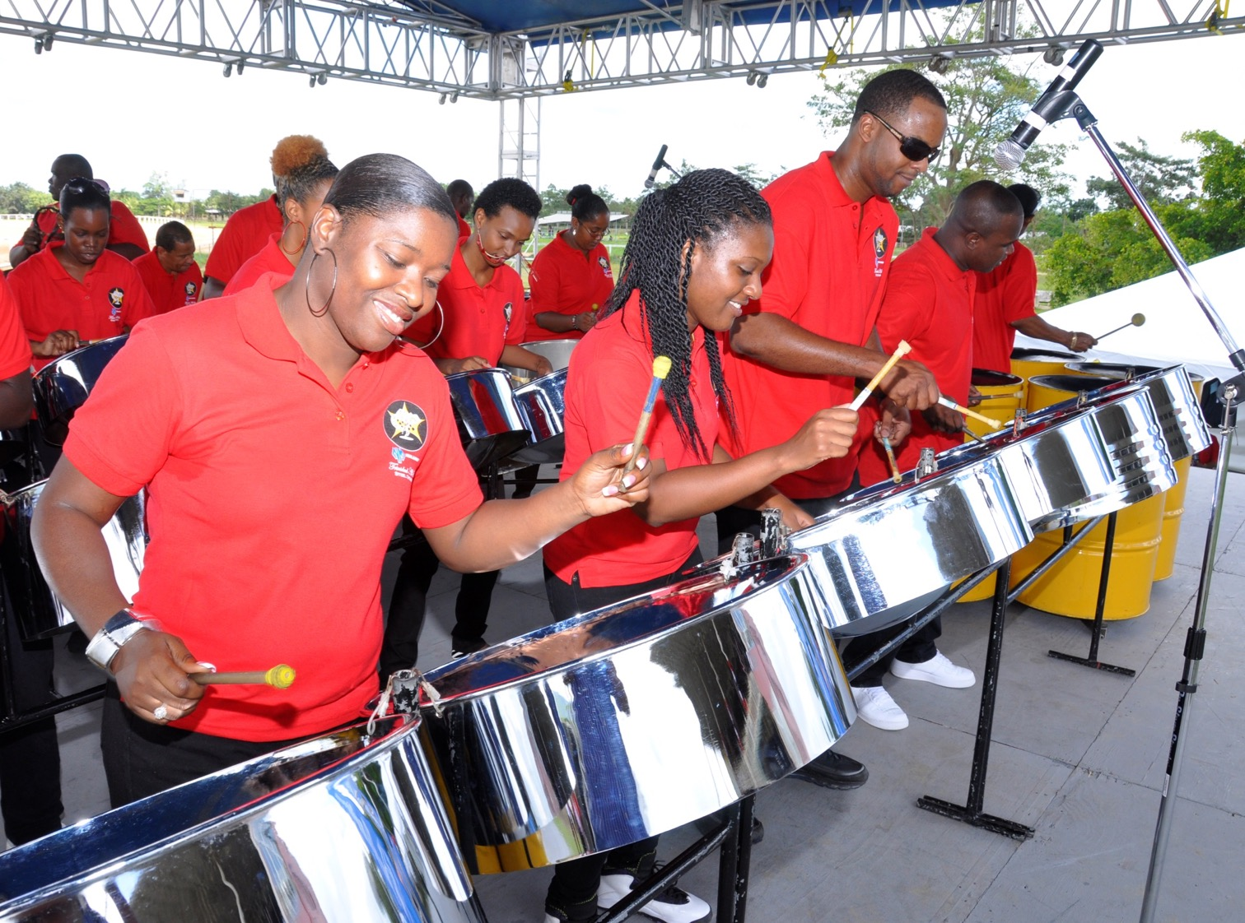

Slide 52
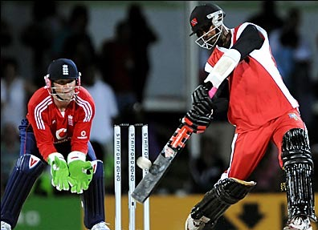
Cricket

Slide 53
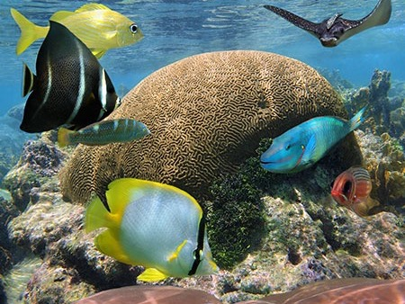

Slide 54
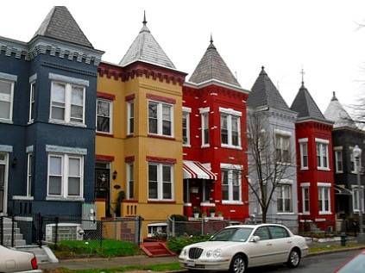

Slide 55

U.S. Virgin Islands

Slide 56
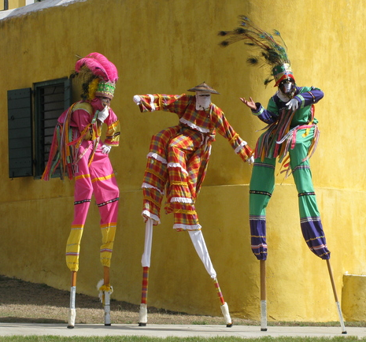

Slide 57
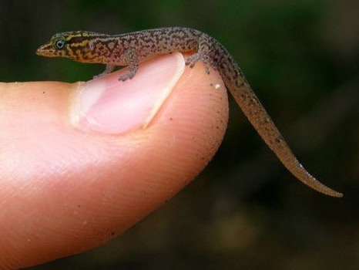

Slide 58
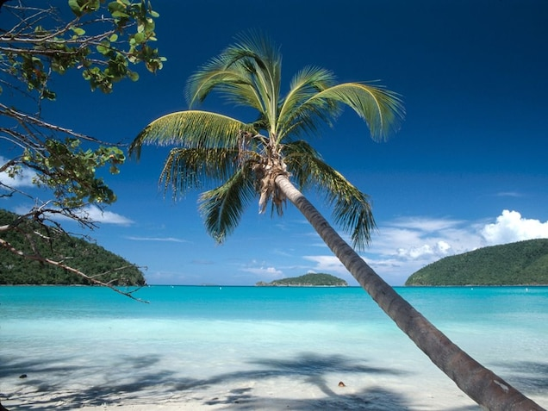

Slide 59
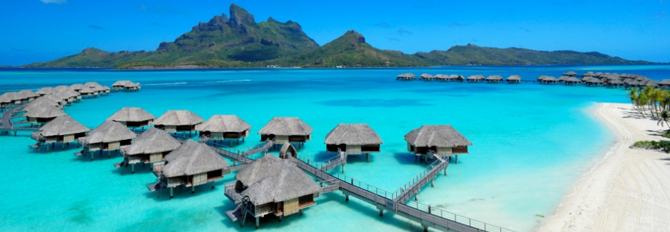
Windward Islands

Slide 60
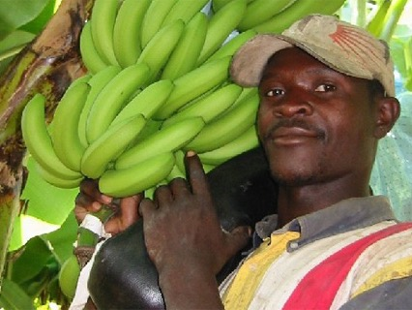

Slide 61


Slide 62


Slide 63
Caribbean Field - Part 3
ST. MARTIN, GUADELOUPE, MARTINIQUE
FLORIDA
MEXICO
Curacao
FRENCH GUIANA
SOUTH AMERICA
Guyana

Slide 64

Martinique

Slide 65


Slide 66


Slide 67


Slide 68


Slide 69

French Guiana

Slide 70


Slide 71


Slide 72

Guyana

Slide 73


Slide 74


Slide 75


Slide 76

Curacao

Slide 77


Slide 78


Slide 79
North Central America FIELD
FLORIDA
MEXICO
Guatemala
Cyr Home
Honduras
El Salvador
SOUTH AMERICA

Slide 80

Guatemala

Slide 81


Slide 82


Slide 83


Slide 84

El Salvador

Slide 85


Slide 86


Slide 87


Slide 88

Honduras

Slide 89


Slide 90


Slide 91


Slide 92
MEXICO FIELD
FLORIDA
MEXICO
SOUTH AMERICA
MEXICO

Slide 93


Slide 94


Slide 95


Slide 96


Slide 97


Slide 98


Slide 99



Slide 100
CENTRAL SPANISH FIELD
FLORIDA
MEXICO
DOMINICAN REPUBLIC
CUBA
PUERTO RICO
Nicaragua
COSTA RICA
SOUTH AMERICA
PANAMA

Slide 101

Cuba

Slide 102


Slide 103



Slide 104


Slide 105


Slide 106


Slide 107

Dominican Republic

Slide 108


World Baseball Classic Champions

Slide 109


Slide 110


Slide 111


Slide 112

Puerto
Rico

Slide 113




Slide 114


Slide 115


Slide 116


Slide 117

Nicaragua

Slide 118


Slide 119


Slide 120


Slide 121

Costa Rica

Slide 122


Slide 123


Slide 124

Coffee beans

Slide 125


Slide 126

PANAMA
Panama

Slide 127


Slide 128


Slide 129


Slide 130

Panama Canal

Slide 131


Slide 132




Slide 133



Slide 134


Slide 135


Slide 136


Slide 137


Slide 138


Slide 139


Slide 140


Slide 141


Slide 142




Slide 143



Slide 144
FLORIDA
MEXICO
CUBA
SOUTH AMERICA

Slide 145




Slide 146

HOLGUIN
MEXICO CITY

Slide 147


Slide 148


Slide 149


Slide 150
FLORIDA
MEXICO
CUBA
SOUTH AMERICA

Slide 151



Slide 152





Slide 153


Slide 154


Slide 155



Slide 156





Slide 157
MEXICO
GUATEMALA

Slide 161


Slide 162


Slide 163


Slide 164



Slide 165


Slide 166


Slide 167


Slide 168


Slide 169






Slide 170


Slide 171


Slide 172


Slide 173


Slide 174


Slide 175


Slide 176


Slide 177


Slide 178


Slide 179



Slide 180


Slide 181


Slide 182


Slide 183


Slide 184


Slide 185


Slide 186


Slide 187


Slide 188


Slide 189



Volunteer Missionaries

Slide 190


Leaders
Training

Slide 191



Slide 192


CUBA
MEXICO

Slide 193

PANAMA VBS

Slide 194

GUATEMALA

Slide 195


EL SALVADOR

Slide 196


HONDURAS

Slide 197







Slide 199


Slide 200


