Slide 1
South Sudan
A Scattered People

Slide 2
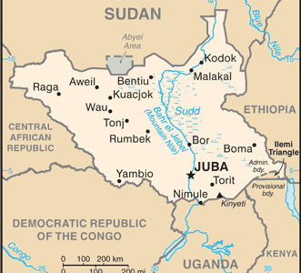
South Sudan
Located in East-Central Africa.
Separated from Sudan to the north after years of civil war.
Became the newest country in Africa 2011.
2 million refugees are in South Sudan.
South Sudan is one of the poorest countries in Africa.
Notes:
Map from https://www.cia.gov/library/publications/the-world-factbook/geos/od.html

Slide 3
How much is one million?
2.5 million people died in Sudan’s civil war
4 million people were displaced

Slide 4
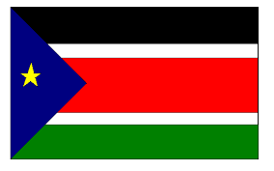

Slide 5
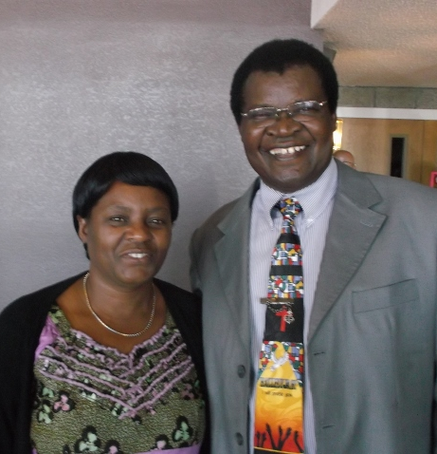
Friday and Mary Ganda
Worked to open the ministry in South Sudan before the Church of the Nazarene officially entered.
The Gandas are missionaries and have served on the West Africa, East Africa and Horn of Africa fields.
Notes:
NMI profile picture

Slide 6
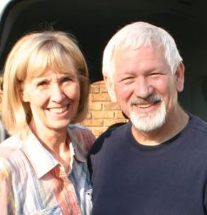
Howie and Bev Shute
Served as Nazarene Global Missionaries to East Africa and the Horn of Africa from 1997 to 2008.
Helped establish ministry bases that contributed to opening the work in South Sudan.
Presently serves as Pastor of Victory Hills Church of the Nazarene, Kansas City, Missouri.

Slide 7
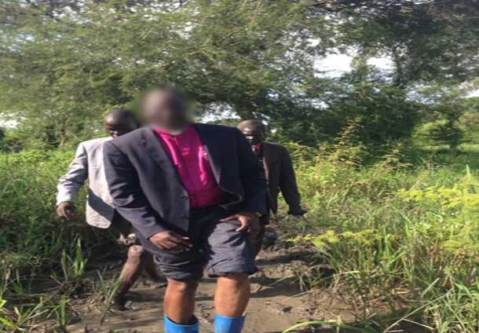
Pastor John
walked 7 days to South Sudan from Ethiopia to answer God’s call.
Notes:
John Yual picture

Slide 8
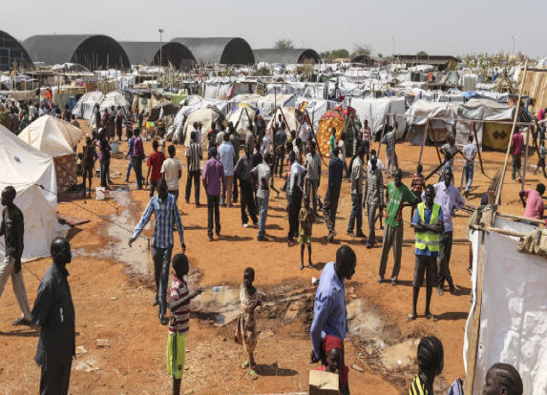
A refugee camp
In South Sudan
where Pastor John started his work.
Notes:
John Yual picture

Slide 9
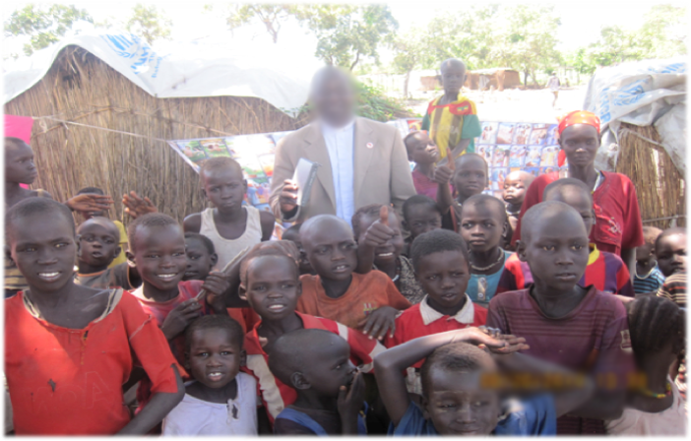
“Where God has called me…”
Pastor John
Notes:
John Yual picture

Slide 10
An Ethiopian Refugee Camp with Pastor John
Notes:
John Yual picture

Slide 11
“If we fail to attract people,
we should be asking,
What is wrong?”
Pastor John

Slide 12
People need love!
Notes:
John Yual picture

Slide 13
Pray for South Sudan
for the protection of leaders in refugee camps.
that Christians will be bold and persevere.
that new Christians will take Christ back to their homelands when it is safe to return.
that displaced people will experience love from those who share Christ with them.

